Slide 1
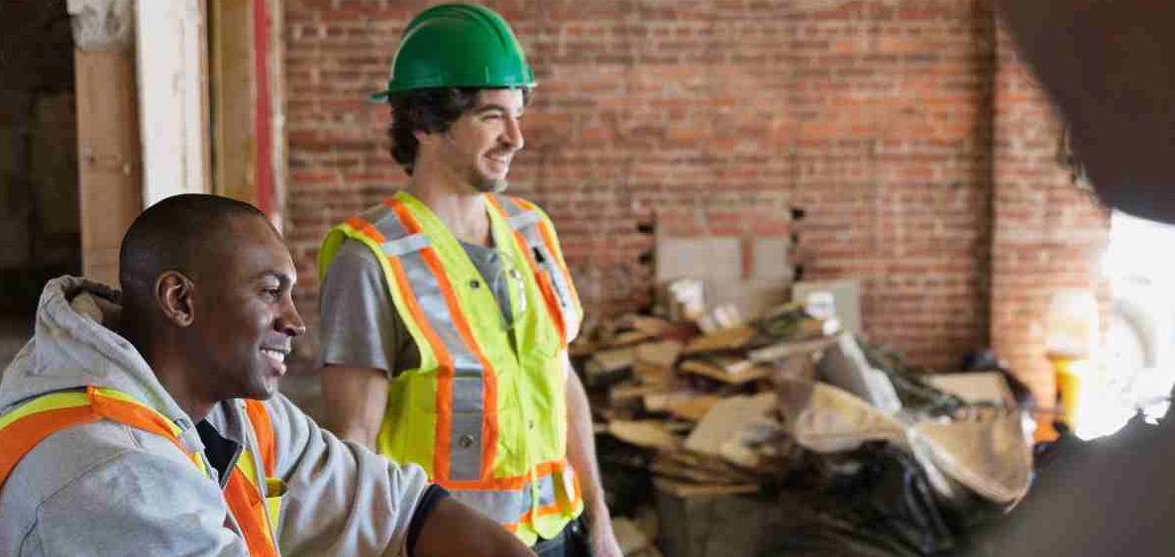
MENTAL HEALTH AWARENESS
Notes:
HOLDING SLIDE… this to be shown as people enter the room to recognise they are in the right place.
When everyone is in the room simply click to next slide.

Slide 2






MENTAL HEALTH AND WELLBEING IN CONSTRUCTION
On average there are
39 fatalities on building sites each year
Every year, there are over 82,000 reported cases of new / long standing
work-related illnesses that can be directly attributed to working within construction
Every year over 2.4 million
working days are lost through injury
or illness in construction
Stress, anxiety or depression account for 1 in 5 of all reported
work-related illnesses
The risk of suicide among male labourers, particularly in construction roles, is four times higher than the male national average
A construction worker is more likely to die from suicide than
a fall from height
Notes:
Today’s toolbox talk is centred around mental health awareness.
The statistics around mental health in our industry are shocking.
Stress, anxiety or depression account for 1 in 5 of all reported work-related illnesses. As an example, the risks of suicide among male labourers, particularly in construction is 4 times higher than the male national average.

Slide 3
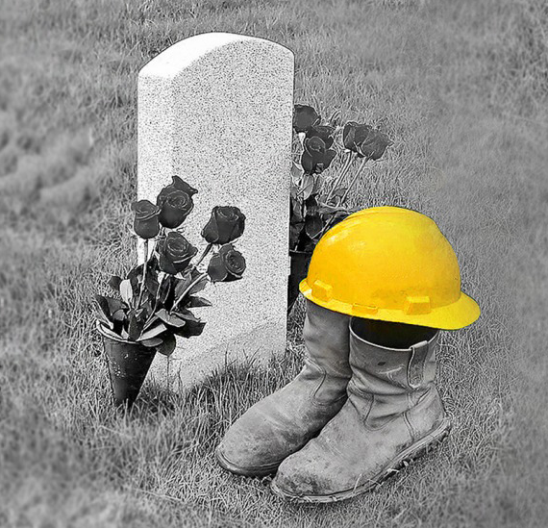

Every working day
in the UK and Ireland
2
CONSTRUCTION
WORKERS
take their own life
Notes:
In fact, every working day in the UK and Ireland 2 construction workers take their own life.
We all have a role to play in addressing these figures and supporting each other, especially when we’re struggling.

Slide 4
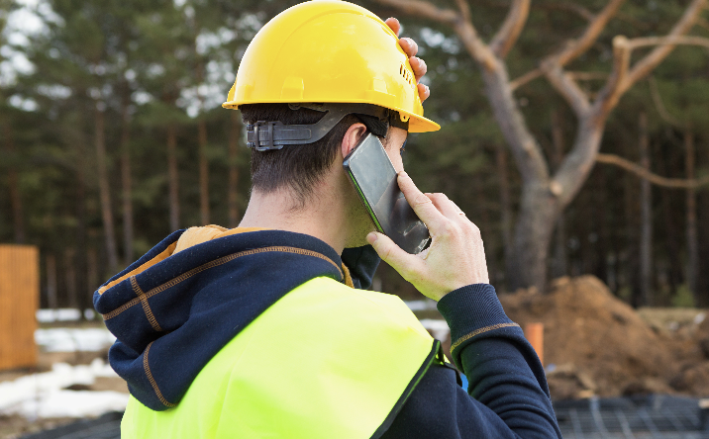


CONVERSATION
What things can be causes of stress and pressure?
HOW DOES IT
MAKE YOU FEEL
AT WORK
OUTSIDE OF WORK
Notes:
This toolbox talk is not training… it is about raising awareness of a significant issue in our industry and promoting a process to start the conversation.
So, let’s start right now. In threes, have a conversation for 3 minutes about potential causes of stress and pressure.
Feedback to the group (3 minutes)

Slide 5
SOURCES OF STRESS
Even happy events can cause stress in our lives. When it goes unaddressed for too long, stress can trigger mental and physical health issues.
LIFE CHANGES
EMOTIONAL
PHYSICAL
ENVIRONMENTAL
CHANGES AT WORK
Leaving home, getting married, having children
Divorce/relationship breakdown
Health scares or physical illness
Accidents or bereavement
Legal issues, arrest or imprisonment
Peer pressure
Conflicting cultural values and beliefs
Coping with uncertainty
Late nights or
lack of routine
Poor diet
Misuse of alcohol
or drugs
Poor housing or accommodation problems
Social isolation
Unemployment
Adjusting to new environments (moving house / travel)
Financial pressures
Starting a new job
Coping with an increased workload or a promotion
Poor relationships with colleagues or managers
Redundancy, or the fear of it
Notes:
There are lots of sources of stress – even happy events can cause stress in our lives. For example [point out a number of examples].
Stress is a natural response to pressure. It becomes a problem when it goes unaddressed for too long, at which point it can trigger mental and physical health issues.

Slide 6











Notes:
Now I want to talk more specifically about Mental Health.
Because the fact is WE ALL have it. It is the combination of the way we think, the way we feel at a certain time. Angry, happy, sad. In fact, it is really our overall wellbeing which is a huge mixture of many factors.
However, the fact still remains, we all have mental health in the same way we all have physical health – the only difference is that we have a better understanding of physical health and find it easier to talk about it and show compassion and empathy.
Stigma is one of the biggest barriers to construction workers getting support and talking about issues they’re struggling with. This stigma is further reinforced by the media, in films, newspapers, Twitter feeds, Facebook.
The fear of judgement stops many of us from getting help or speaking to a mate about what’s on our minds.

Slide 7
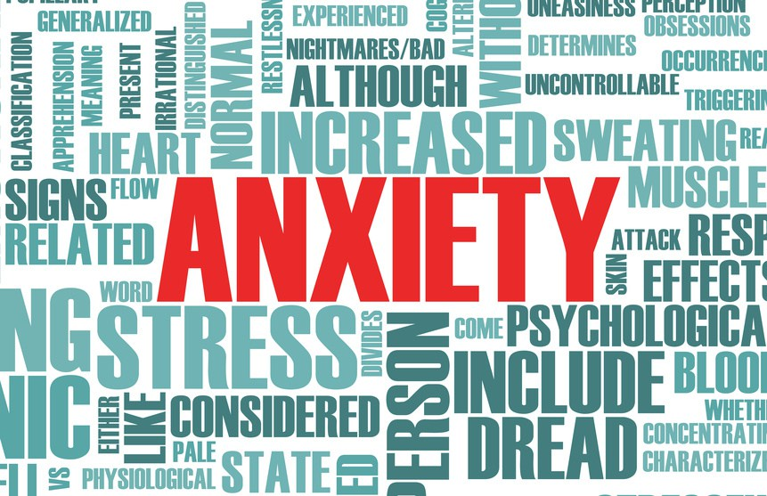
SOME SIGNS OF DISTRESS
Timekeeping
Safety and Risk Taking
Alcohol and/or drug misuse
Lack of co-operation
Being tired all the time
Unexplained aches and pains
Quiet and withdrawn
Extremes of emotion
Notes:
We know that stigma stops many people opening up a conversation about things they’re struggling with, so a way to help address that is to become more aware of the signs somebody is struggling so you can approach them and see if they want to talk.
But it’s not always easy to know when somebody might need to talk.
If you have been working with somebody for a while the biggest sign that they may be struggling is some sort of change.
This could be... [Pick from list and emphasise a particular point].

Slide 8
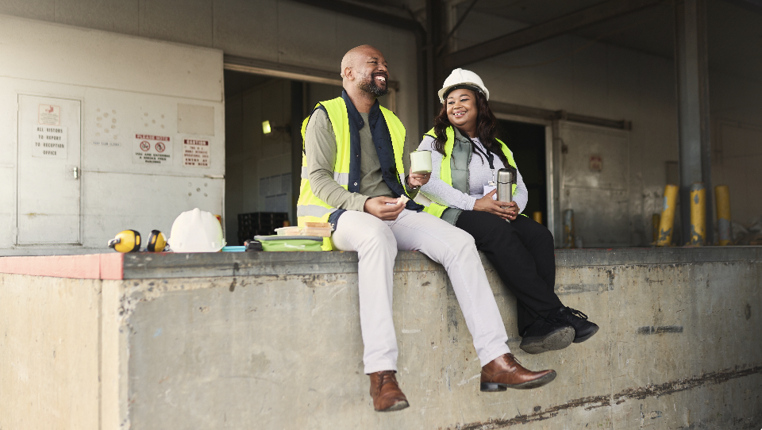
CONVERSATION
What do you do if you are suffering with your mental health?
What do you do if you think
a workmate is suffering with their mental health?
Notes:
Back in your 3s again, have a conversation for 3 minutes on the following topics.
Feedback to the group (3 minutes)

Slide 9

WHAT NOT TO SAY TO A WORKMATE
EXPERIENCING A MENTAL HEALTH PROBLEM
You need to get out more
It’s all in your mind
You have nothing to worry about
Stop complaining all the time
I always knew you had a problem
There is nothing wrong with you
Stop looking for attention
You don’t look anxious or depressed
You aren’t pushing yourself enough
It sounds like you are going crazy
You need to stop feeling sorry for yourself
Just snap out of it, get over yourself
Things could be so much worse
No one ever said life was fair
You are always so negative
Things aren’t that bad
It’s your own fault
Notes:
Talking about mental health struggles can make people feel vulnerable so it’s important to think about how you listen and importantly what you say.
Back in your groups, have a talk about some of these responses and how you think they would make you feel if you were opening up.
Feedback to the group (3 minutes)

Slide 10
WHAT CAN YOU DO TO HELP?
Reach out and be willing to listen
Find a good place to talk
Put away your phone and other distractions
Be patient
Focus on what they’re saying
Reassure them
Signpost them to help
Encourage them to reach out if they need to talk again
Notes:
As simple as it sounds, being able to speak to somebody about an issue or mental health struggle can offer a huge amount of relief. So, if you thinking somebody is struggling, reaching out and being prepared to hear them out could be a huge help.
When people ask how we are, more often than not we’ll reply that we’re fine. In order for people to open up, they need to feel like you care and safe to speak about what’s on their minds.
To do that, it’s important to find a good time and place to talk and give them your full attention so they know you care about what they have to say.
Sometimes it can be hard to find the words to explain how you’re feeling so be patient, don’t feel like you need to fill pauses or predict what they might say.
Rather than try to find solutions, focus on what they’re saying.
Make sure they’re aware of the free support available to them and lastly encourage them to feel like they can speak to you if they need to in the future.

Slide 11

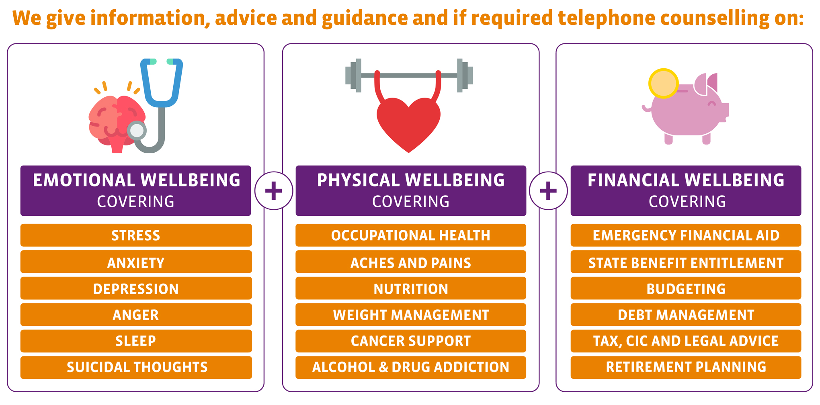
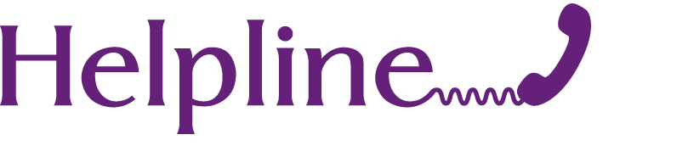
FREE SUPPORT WITH LIGHTHOUSE
CONSTRUCTION INDUSTRY CHARITY
The team can provide information, advice and guidance
and telephone counselling on:
UK 0345 605 1956
ROI 1800 939 122
24/7 FREE AND CONFIDENTIAL ADVICE
TO ANYONE WORKING IN CONSTRUCTION
Notes:
One of the places you can signpost workmates to is Lighthouse construction charity. They offer free support to construction workers and their families, to help improve the emotion, physical and financial wellbeing of the construction community.
Lighthouse construction charity offers a range of free support for construction workers and their families.
Mental and physical health, and financial wellbeing are all connected so the organisation offers support across all three areas.

Slide 12
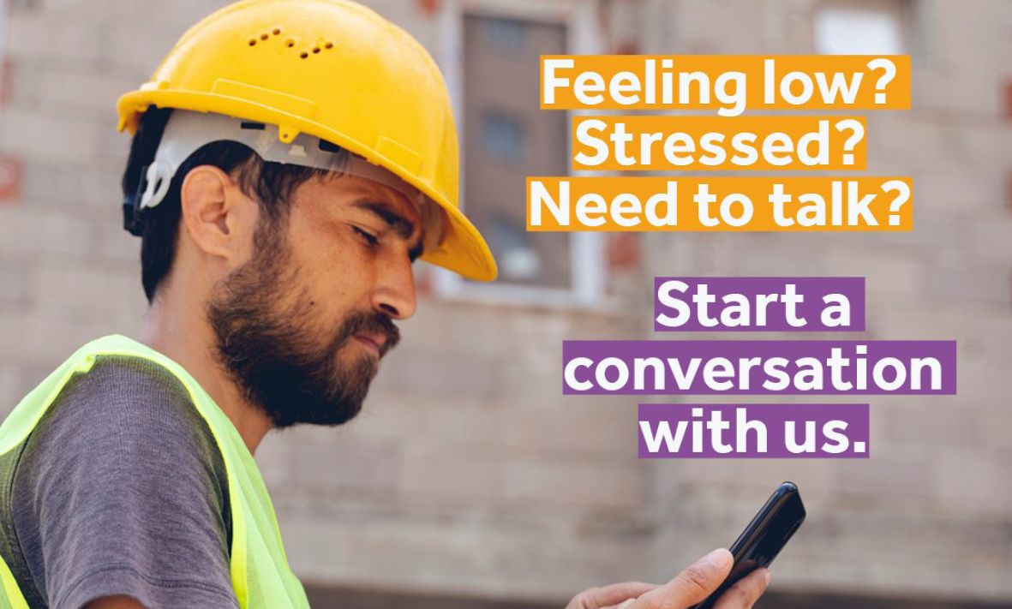

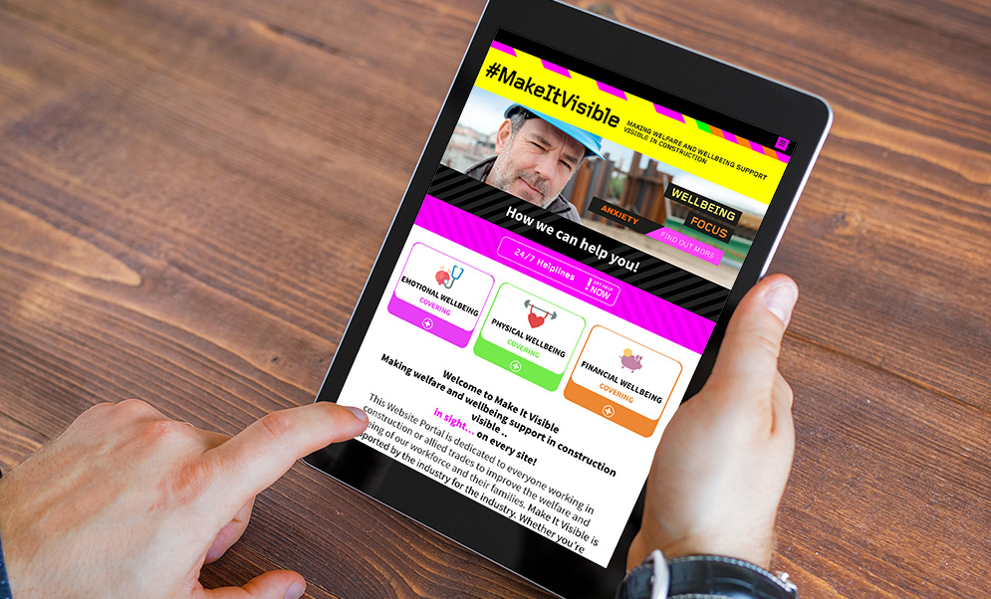

FREE SERVICES
TEXT ‘HARDHAT’
24/7 service that gives immediate access
to text back counselling
Text HARDHAT to 85258 (UK)
Construction Industry App
Offering advice on a variety
of issues, self-assessment
tools, coping strategies and
referral pathways to access
expert advice and support.
#MakeItVisible Portal
An online portal dedicated to improving the welfare and wellbeing of everyone working
in construction or the allied trades.
Notes:
[Action group to save the number and make the point that you never know when you might need it for yourself or somebody you know].

Slide 13
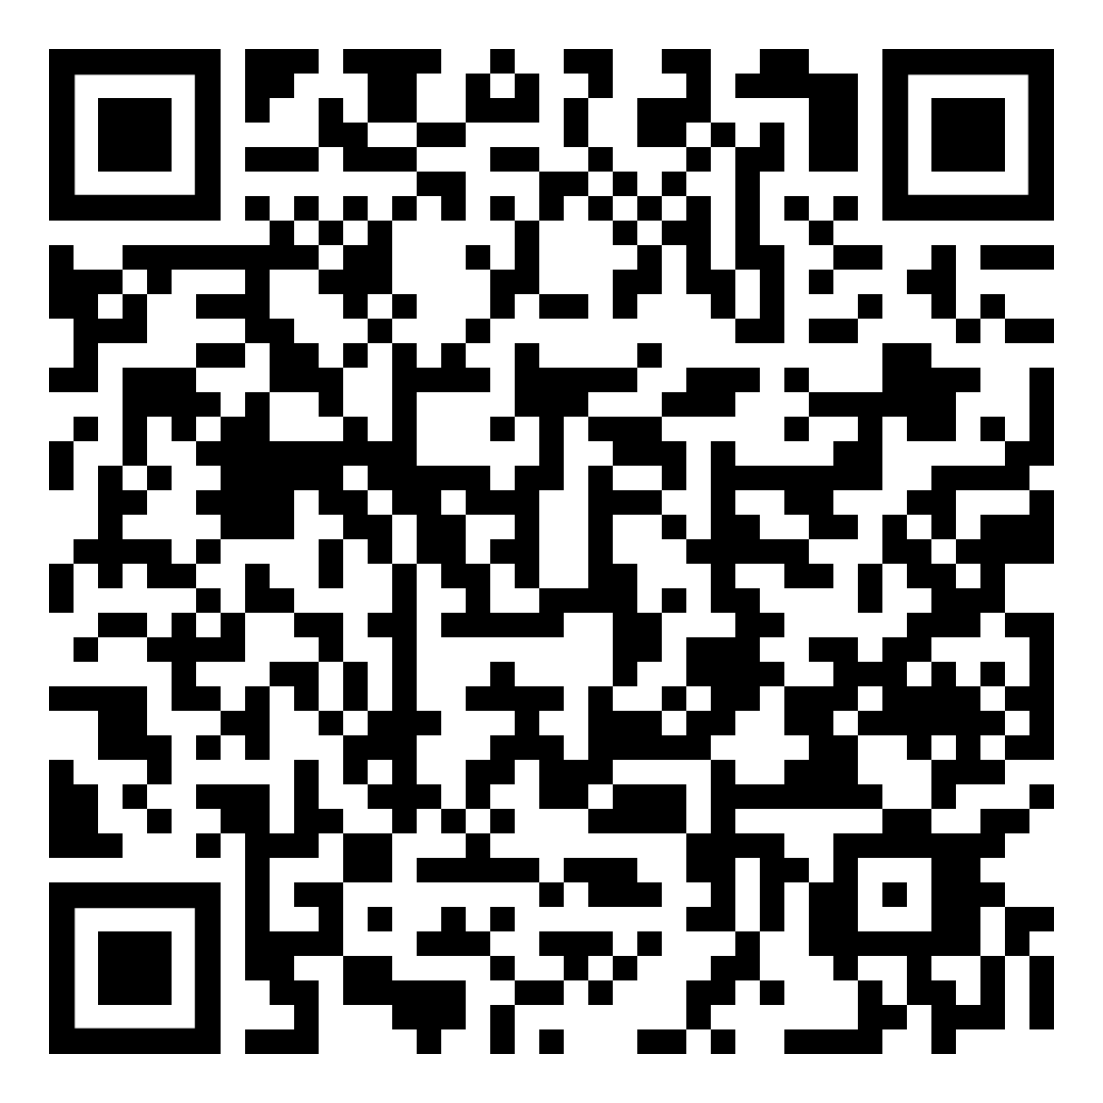
FREE ONLINE MENTAL HEALTH TRAINING
Sign up today
Scan to book or visit HBF.co.uk
The Home Builders Federation and the Lighthouse Charity have teamed up to offer free online training to increase mental health awareness
within the home building industry and support with common triggers for the construction community.
Notes:
Because [insert your organisation’s name] is a member of HBF, we’re able to offer all on site workers access to free online wellbeing training, helping to address common triggers for stress and anxiety amongst the construction community, including subjects like money management.
Visit the HBF website to see what training they have upcoming. [action to scan QR code].

Slide 14




IF YOU ARE STRUGGLING
YOU ARE NOT ALONE.
So far this year, the Lighthouse Charity has:
Supported
Delivered
2,146
3,942
families
Family meals
Facilitated
Financially supported
1,577
1,267
Counselling sessions
Families
Notes:
[Make the point that there’s no shame in getting support and/or help in managing your wellbeing and mental health].

Slide 15
SUMMARY
We all have mental health
Mental health problems are common, even more in construction and it can affect anyone, anytime
Stigma stops us talking, so let’s get the conversation going
It takes courage to talk about how you really feel
Look after your own mental health and look out for others
TOGETHER, WE CAN MAKE A HUGE DIFFERENCE
Notes:
[Summarise the points on the slide].
Hopefully you will take something away from today.

Slide 16


3 GOLDEN NUGGETS
SEEK TO UNDERSTAND BEFORE YOU SEEK TO BE UNDERSTOOD
ASK TWICE
ALWAYS
BE KIND
Notes:
I appreciate taking in so much information can be overwhelming but there are 3 golden nuggets of wisdom that everyone can embrace to make construction a better place to work for this generation and the next. If everyone can practice these 3 simple guidelines we will all be on the road to better wellbeing.
Take care of others …. In the end promoting good mental health is all about being a decent human being to another human being.
Thank you.

Slide 17

Access support at lighthouseclub.org

