Slide 1
Practical Application of the High-Rise Buildings Regime – Design and Construction
Live Webinar

Slide 2
BSR Update

Slide 3
Building Safety Regulator
Andrew Moore, Head of Building of Control and Craig Renton, Building Safety Regulatory Lead

Slide 4
Building Control : Milestones
Application received
Sewage statutory consultations issued
0
0
0
Validate
0
0
0
Full assessment report completed
0
0
0
MDT resource request submitted
0
0
0
Fire Statutory consultation issued
0
0
0
Confirm MDT resource
0
0
0
Confirm overall regulatory decision
0
0
0
Initial MDT meeting
0
0
0
Issue decision
0
0
0

Slide 5
Building Regulation compliance document – Poor example
Building Regulation Compliance | Evidence
Part A Building regulations Approved Document A | Drawing XZY Plan ABC Document HIJ
Identification
Required
Interpretation required

Slide 6
Building Regulation compliance document - requirements
Identify - all elements that require BR compliance (granular detail)
Clarify - What standard / code / document are you complying with? Why is this the right code?
Justify - must set out a narrative to explain how compliance had been reached for every aspect that needs BR compliance. Explain how you demonstrate this!

Slide 7
Building Safety Regulator
Josh Paulin, Policy Advisor, HSE

Slide 8
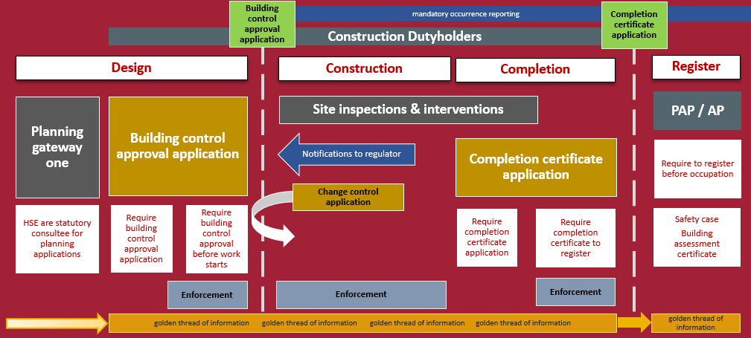
Notes:
Preparation
Building Control Approval Application
Building work (including change control)
Completion Certificate Application
Using the building once building work has finished
Requirement for completion certificate before occupation
s76 Building Safety Act 2022
76 (1) This section applies if any of the following works are carried out—
the construction of a higher-risk building;
the creation of additional residential units in such a building;
works to a building that cause it to become a higher-risk building.
Partial Completion Certificates
Regulation 45(2) The Building (Higher-risk building procedures)(England) regulations 2023
45.(1) This regulation applies where—
(a) HRB work or a stage of HRB work is being carried out in relation to a building and the building (or any part of it) is to be occupied before completion of the work;
(b) work to existing HRB is being carried out in relation to a building and before completion of the work—
(i) any part of the building which ceased to be occupied in order for the work to be carried out is to be re-occupied, or
(ii) any new unit created by the work is to be occupied before completion of the work.
(2) Where this regulation applies, before the occupation referred to in paragraph (1) the client must make an application for a completion certificate in relation to part of the work for the building (“partial completion certificate application”) in writing to the regulator, signed by the client (in this regulation “the applicant”), the application must include— …
Other regulatory regimes continue to apply. (HSWA, FSO etc.)

Slide 9
Construction Control Plan
Management arrangements – Three aspects
Managing the contractors and designers
Procedures to check competence and serious sanctions
Cooperation
Communication
Managing the quality of the building work
Supervision
Instruction
Training
Managing the collection and storage of evidence to support the CC application
(The Golden Thread of Building Information)
What evidence?
Collected by who? When? How?
Notes:
Main ‘hook’ for RBI will be the third point – What evidence do they want/ expect to see presented at the CC application?
Well, the BCA application is supposed to set that out in anticipation so you as RL need them to tell you if the evidence that is proposed will allow you to approve the CC application.
The other two points at things that they will have made judgements on, but they have not had the legal language to articulate their assessment of the contractors. Which are ok, which need more checking.

Slide 10
CLC Update

Slide 11
Karl Whiteman
CLC Industry Sponsor
Executive Director– Berkeley Group

Slide 12
CLC Vision Lead a new era of delivery in the Built Environment CLC Mission Working in partnership with industry, clients and government we will develop an industry that has the capability, capacity and resilience to: Support the industry to respond to the current economic challenges Drive growth and investment Promote the industry Improve productivity through digital adoption, industrialisation and innovation Successfully manage the sector’s transition to Net Zero Create improved societal outcomes

Slide 13
CLC Strategic Priorities Net Zero & Biodiversity Accelerate the sector’s transition to Net Zero and mitigate the impacts of climate change People & Skills Energise our people, attract talent and enhance their skills for the future Next Generation Delivery Boost productivity through digital adoption and industrialisation Building Safety Champion and support delivery of safe and high-quality buildings

Slide 14
CLC Strategic Priorities
CLC Advisors
CLC Board
CLC Council
Building Safety
Next Generation Delivery
People & Skills
Net Zero &
Biodiversity
Golden Thread
Competence
Increasing Regulatory Clarity
Professional Indemnity Insurance
Construction Products

Slide 15
Recent Work – includes: HSE/BSR Building Safety Conference Building Safety Webinar Series Industry response to the Independent Review of the Construction Products Testing Regime Golden Thread Guidance Installer Competence Frameworks Second staircases in HRBs and ADB Building Control Approval for HRBs CLC Building Safety Report Industry Task and Finish Groups for Grenfell Inquiry recommendations Current Issues – includes: Grenfell Tower Inquiry Final Report Construction products regulatory reform Remediation acceleration plan Building Control approval for HRBs

Slide 16
Resources CLC Website CLC Bi-Annual Report 2024 Building Safety Report BSR/OPSS/CLC webinar series and resources

Slide 17
Questions
Use the Q&A function to submit questions to our speakers

Slide 18
Thank you for joining us
Follow us on LinkedIn: the-home-builders-federation
And X: @HomeBuildersFed
Feedback on today’s session and recommendations for future sessions: info@hbf.co.uk
Scan the QR code to view future events

