Slide 1
Planning challenges in home building: the plan-led system in Wales
HBF Webinar: 29 January 2026

Slide 2

Chair
Mark Harris
Planning and Policy Advisor, Wales
Home Builders Federation

Slide 3
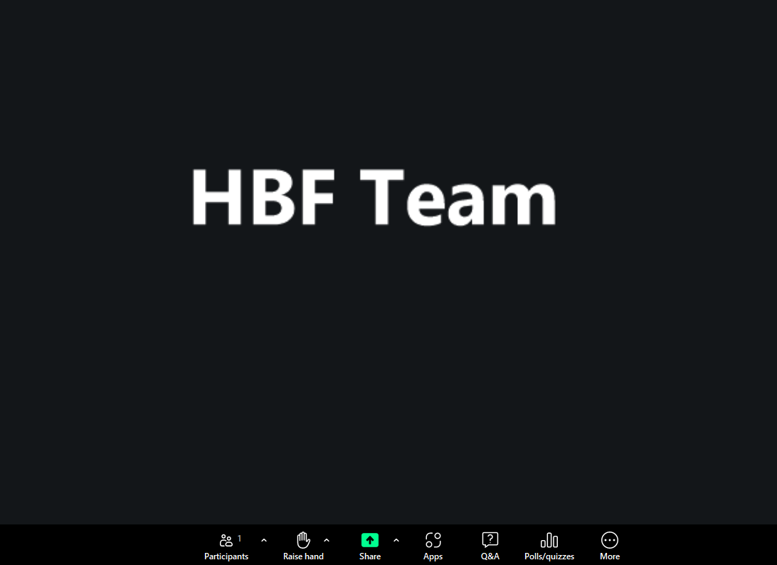
Housekeeping
1.5-hour session, with time at the end for Q&A
Feel free to pose questions throughout the session via the Q&A function
A recording of the session will be circulated and made available on the HBF website.

Slide 4
The plan-led system in Wales

Slide 5

What we plan to cover
Key challenges
Time-expired plans.
The time it takes to review plans.
Reduced planning resources.
Additional policy requirements related to the environment, affordable housing and energy usage.
Consequences of the Wrexham LDP might impact other plans.
Implications for both major and SME house builders.
The growing reliance on fewer large strategic sites.
Strategic Development Plans and LDP lites.

Slide 6
Policy Background
Future Wales: The National Plan
Development Plan Manual 3
The structure of the Welsh planning system
A plan‑led system
Our planning system is development plan led.
Development plans are prepared at national, regional and local scales, with the three tiers
together in combination comprising ‘the development plan’.
The Welsh Government by producing Future Wales contributes to the national tier of the development plan. This is the highest tier of development plan.
Strategic Development Plans cover regional and sub‑regional scales and Local Development Plans consider issues at the local scale.
As plans continue to evolve, the Welsh Government is seeking to reinforce the plan-led system, with plans making a real difference on the ground, achieving practical and positive improvements for local communities and businesses.
Monitoring and review should be an ongoing function of the plan-led system and is a vital aspect of evidence-based policy making.
The legislation is clear that beyond four years, the evidence base becomes dated. LDPS must be kept up-to-date to ensure effective and consistent planning decisions, supporting the objectives of a plan-led system and minimising speculative development.

Slide 7
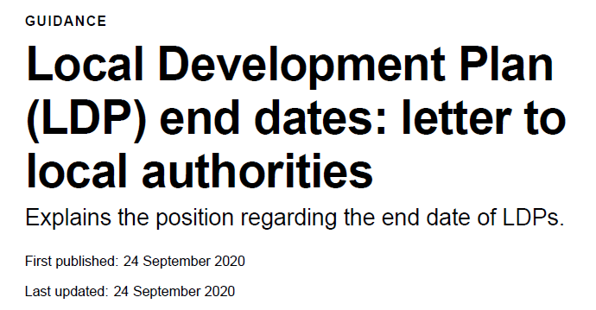
The end date
Current Plans progress
4 plans currently adopted (within last 4 years).
12 plans are time expired adopted pre Jan 2016.
Wrexham LDP adopted and then unadopted.
2026 will see examinations for Cardiff and Monmouth (subject to phosphate issues)
West Wales plans progress affected by marine nitrates.
Plans adopted prior to 4 January 2016 will remain the LDP for determining planning applications until replaced by a further LDP. For those LDPs adopted after 4 January 2016, the plan will cease to be the LDP on expiry of the period specified in the plan.

Slide 8
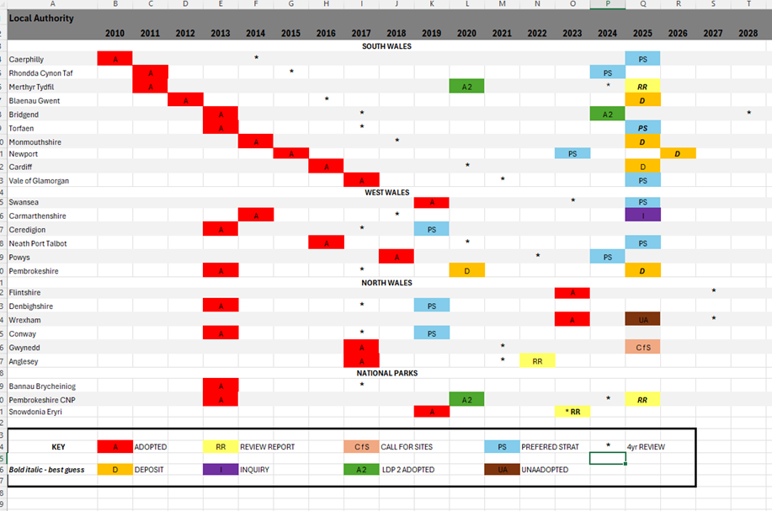
LDP Timeline

Slide 9
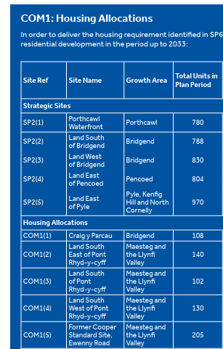
Reliance on larger sites
Bridgend LDP
Total Housing Provision (2018-2033): 8,628
4172 dwellings on 5 strategic sites 48% of the plans provision.
Only 10 allocated sites
Smallest allocated site 102 units

Slide 10

Monmouth example
Local Development Plan 2011 – 2021 adopted in 2014
RLDP – 2018-2033
Review started in 2018
Delivery agreement – “I will also expect DAs to demonstrate that plan preparation can be achieved within 3.5 years from formal commencement of the process, with a single additional slippage period of 3 months. … I should state quite clearly …I will not be minded to agree any further extensions to the DA beyond the initial agreement itself.” Cabinet Secretary
Revised delivery agreement 2020 – Adoption Autumn 2023
Intervention by WG to Deposit Plan 2011 – significant reduction in housing numbers.
Submitted for examination in late 2024
Inquiry delayed due to Phosphates questions
Potential Green belt issues due to the lack of SDP progress.
Adoption 2026/27?

Slide 11
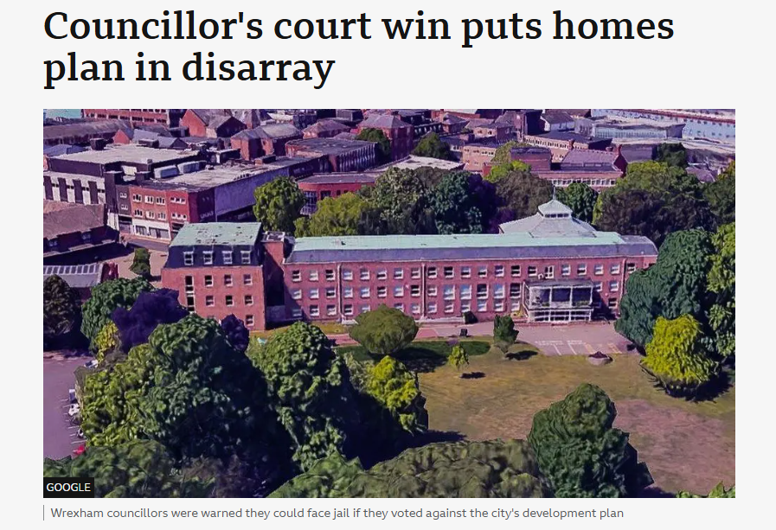
Political Delays
Wrexham LDP - First plan in Wales to be unadopted. WG are still to decide what happens next
In September 2025 – WG confirmed:
‘I can confirm that WCBC have written to Welsh Ministers requesting withdrawal of the plan. The power to withdraw the plan, amongst other options, resides solely with the Welsh Ministers.’
Welsh Elections May 2026
Local elections May 2027

Slide 12
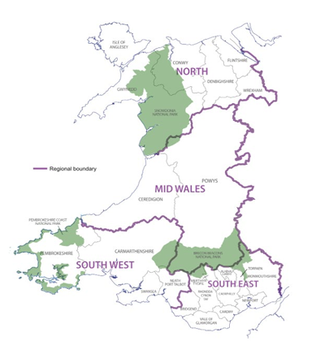
Strategic Development Plans
Town and Country Planning (Strategic Development Plan) (Wales) Regulations 202
In June 2022, the requirement for local authorities to produce an SDP was transferred to the four CJCs
South East Wales SDP – Adoption 2023
South West Wales SDP – Adoption 2031(Draft)
North Wales SDP – Adoption 2032 (Draft)
Breen Belt Issue!

Slide 13
Mark Hand
Director of Profession, International, Cymru and Northern Ireland
Royal Town Planning Institute (RTPI)

Slide 14
Purpose
If we always do what we’ve always done…
Ultimately, what are Development Plans there for?
Key age profile metrics (mid-2022/2023 estimates)
Total population: Approx. 3.1 million
Children (0-15): 17.5% (projected to decrease)
Working age (16-64): 60.9%
Older people (65+): 21.5% (projected to reach c.25% by 2032 and over 1 million by 2060)
Median age: 42 years
Regional variations & trends
Oldest areas: Powys (27.8% over 65), Conwy (27.4%), and Isle of Anglesey (26.4%)
Youngest areas: Cardiff (34 average age) and Newport (38 average age)
Projected growth: The number of people aged 75+ is expected to increase by 22.1% between 2022 and 2032
Source: National population projections: 2022-based [HTML] | GOV.WALES

Slide 15

People
Have we got our priorities right?
Audit Wales report (2019) identified that, in the decade since 2009, LPA services had “seen significant cuts in expenditure with budgets having fallen by 50% in real terms, considering inflation.”
Tranche 2 LDPs & SDPs
Tranche 1 LDPs

Slide 16
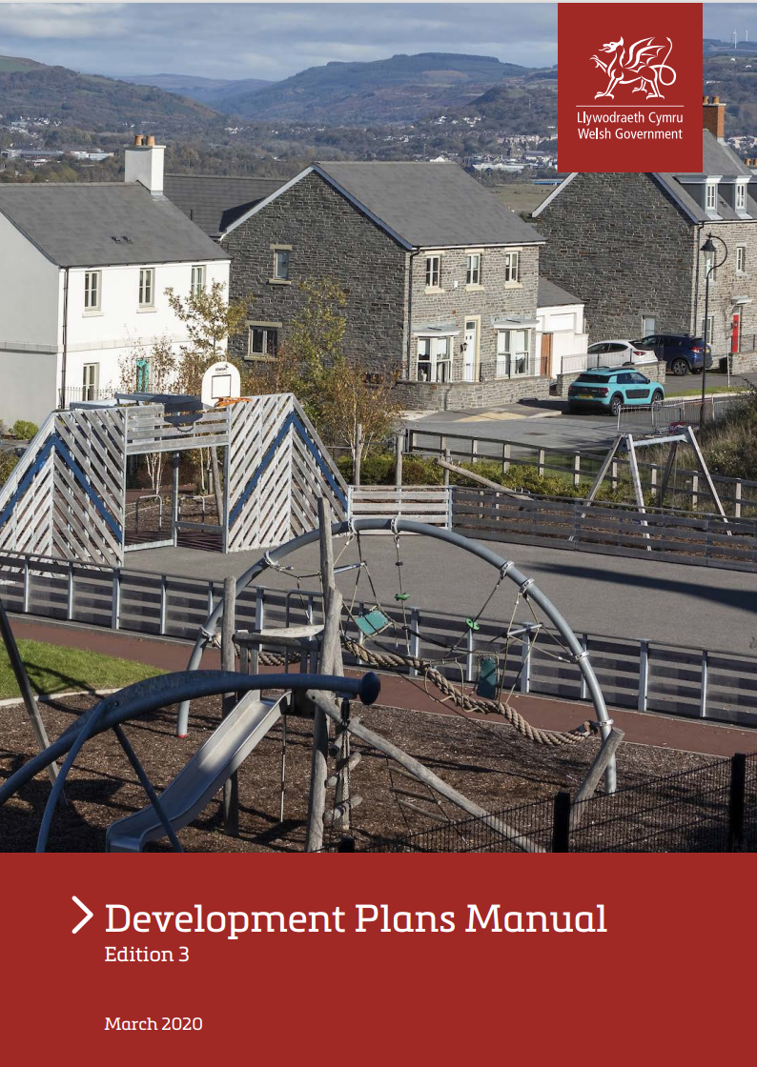
Practice
Do good things come to those that wait?
Has perfection become the enemy of good?
Pros and cons of a front-loaded system?
Deliverability and certainty vs pragmatism
Increased timescales?
Increased expense and risk
Default to larger strategic sites to deliver infrastructure
Unintended consequence of excluding SMEs
Will SDPs help? Plan-led or Plan-only?

Slide 17
Practice
Do good things come to those that wait?
Has perfection become the enemy of good?
Pros and cons of a front-loaded system?
Deliverability and certainty vs pragmatism
Increased timescales?
Increased expense and risk
Default to larger strategic sites to deliver infrastructure
Unintended consequence of excluding SMEs
Will SDPs help? Plan-led or Plan-only?

Slide 18
Politics
Making unpopular decisions
No housing targets + no TAN1 5 year housing land supply requirement
= no incentive for politicians to ‘take control’ and steer where development happens
Plan-making timescales vs political cycles
Governing without a majority / via minority / via coalition
False narrative / fake news
Engagement – if we (and politicians) hear more voices, will some of the above be addressed?

Slide 19
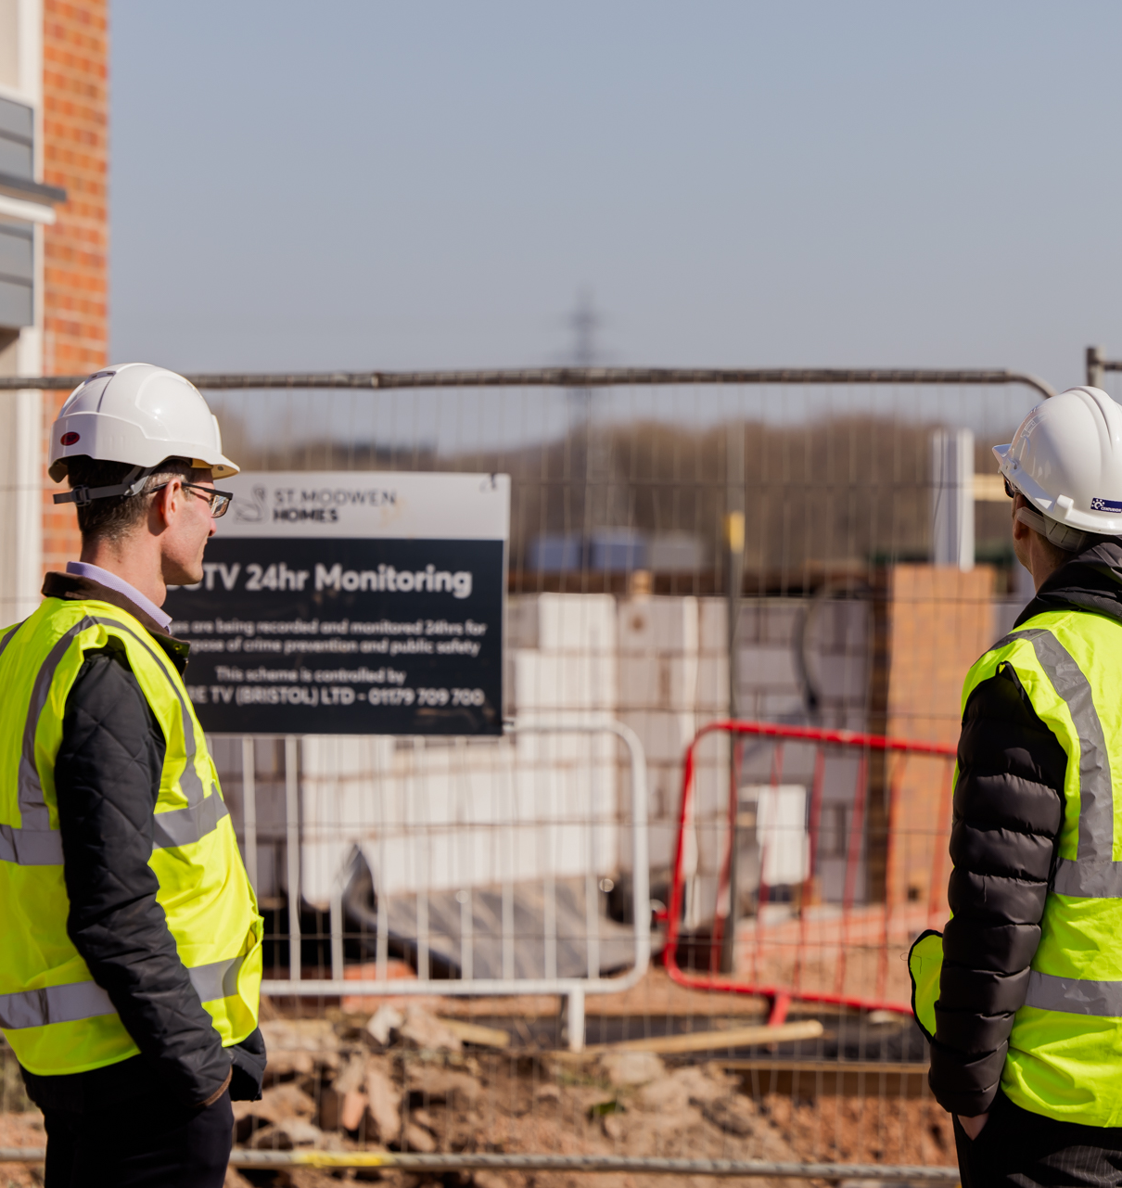
Thank you for engaging
For more information, please contact
Mark Hand MRTPI
RTPI Director of Profession, International, Cymru and Northern Ireland
mark.hand@rtpi.org.uk
07725798383

Slide 20
Hayley Eastment
Policy and External Affairs Manager
Community Housing Cymru (CHC)

Slide 21
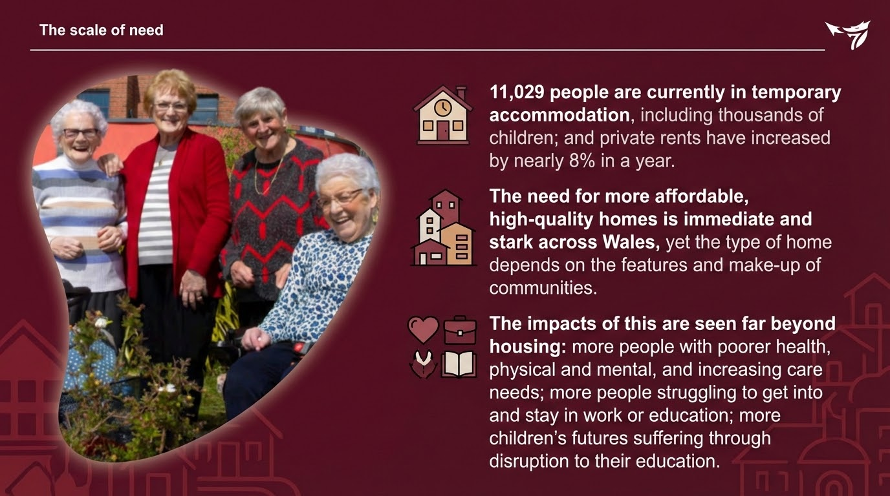

Slide 22
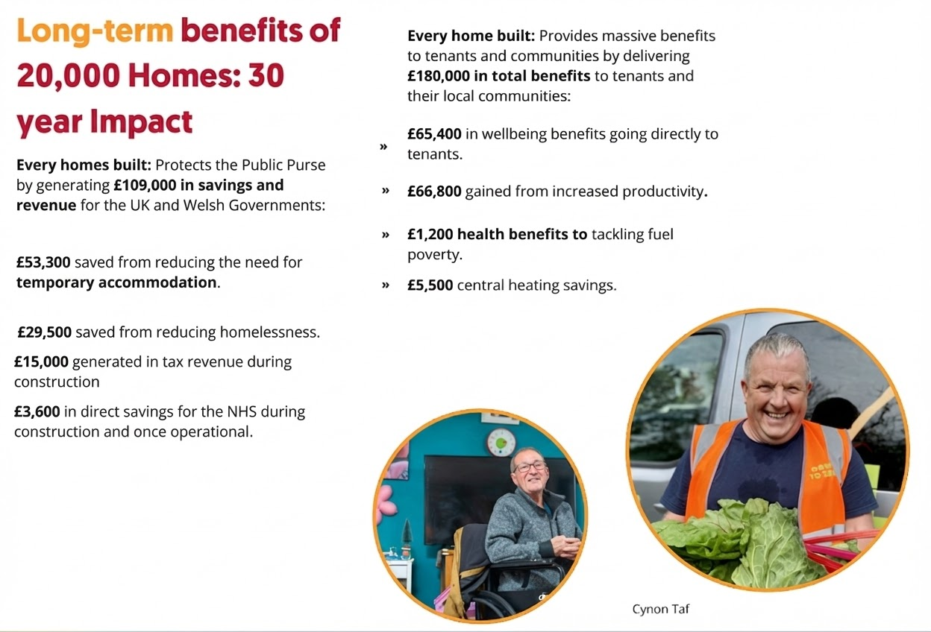

Slide 23
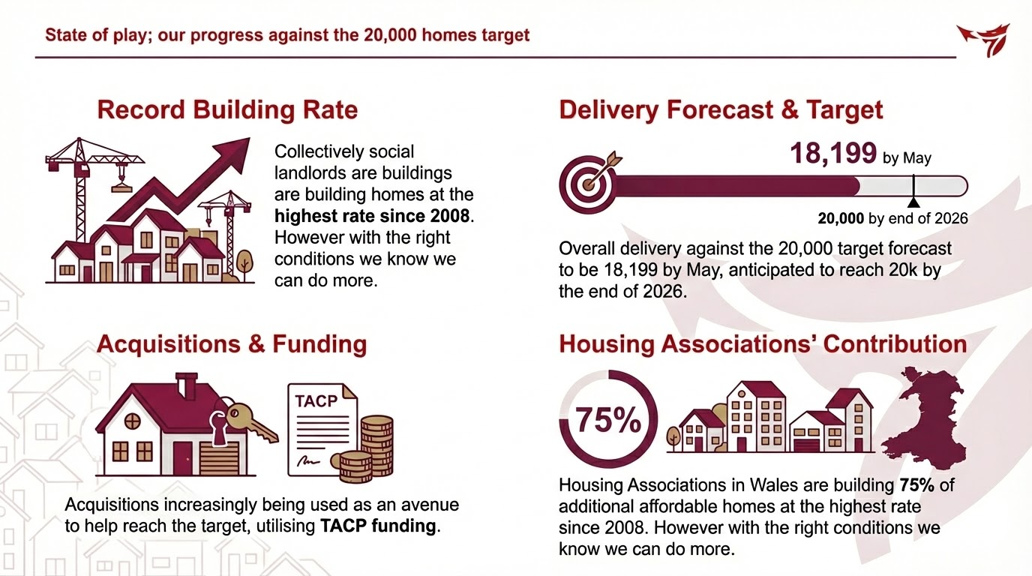

Slide 24
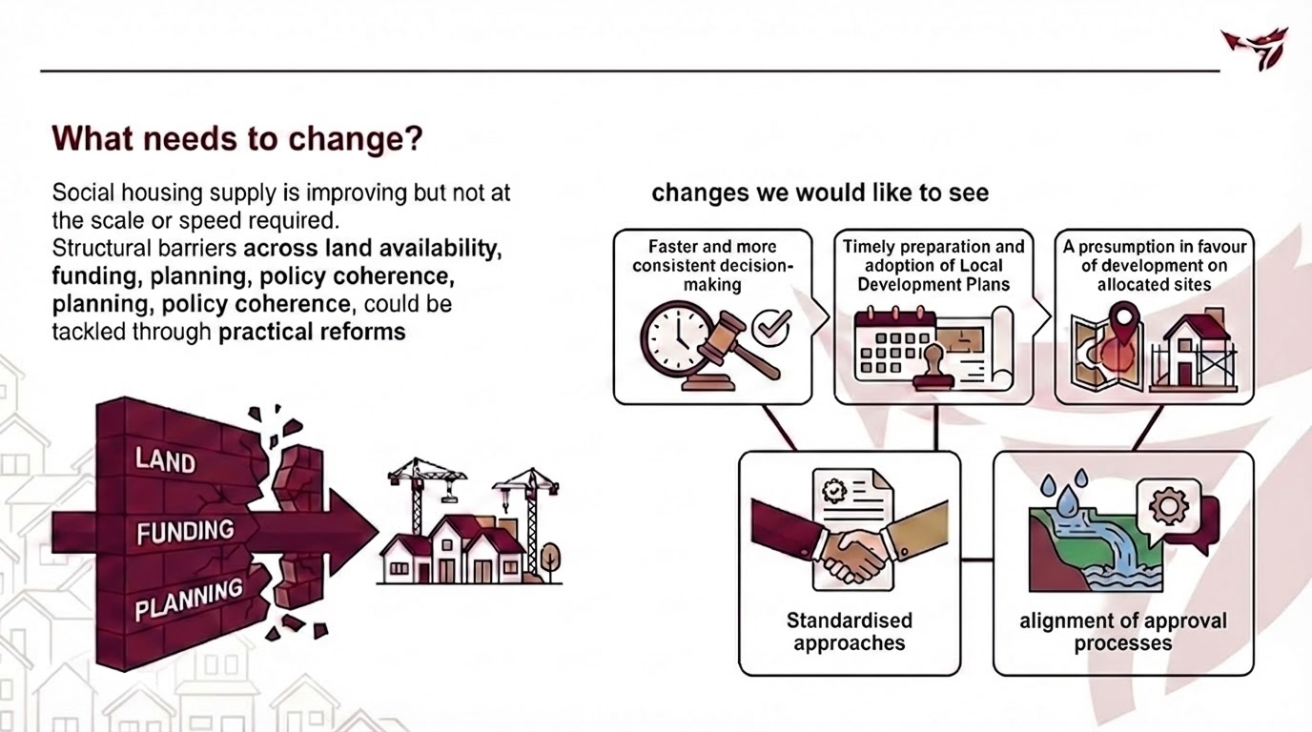

Slide 25
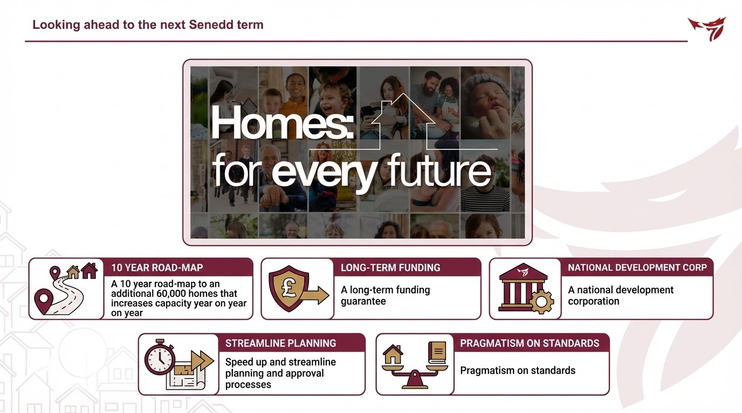

Slide 26
Diolch yn fawr.
Thank you.

Slide 27
Questions

Slide 28

Thank you for joining us
Follow us on LinkedIn: the-home-builders-federation
And X: @HomeBuildersFed
Feedback on today’s session and recommendations for future sessions: comms@hbf.co.uk
Scan the QR code to view future events

