Slide 1
Industry Supporting Further Education: Developing the Future Home Building Workforce
HBF Webinar: 19 March 2026

Slide 2

Chair
Andy George
Director of Industry Attraction and Skills
Home Builders Federation

Slide 3

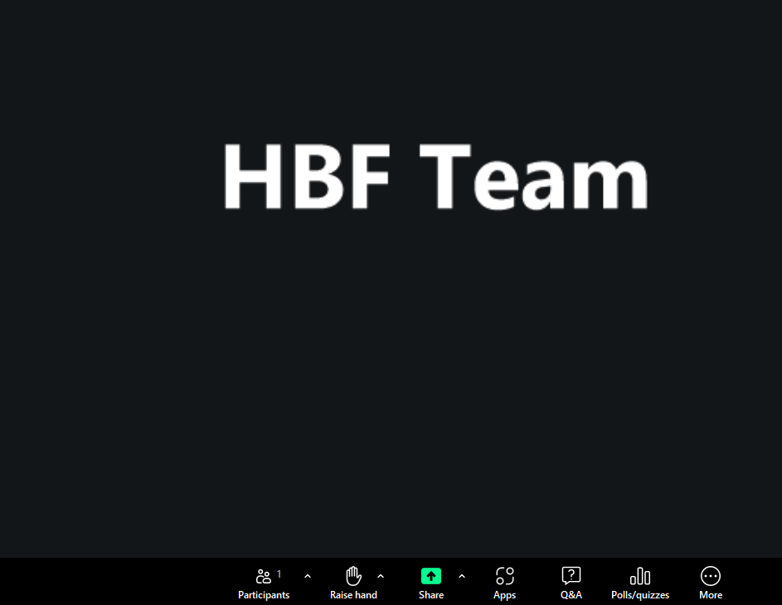
Housekeeping
1 hour session, with up to 30 minutes at the end for Q&A
Feel free to pose questions throughout the session via the Q&A function
A recording of the session will be circulated and made available on the HBF website.

Slide 4
Partner a College programme

Slide 5
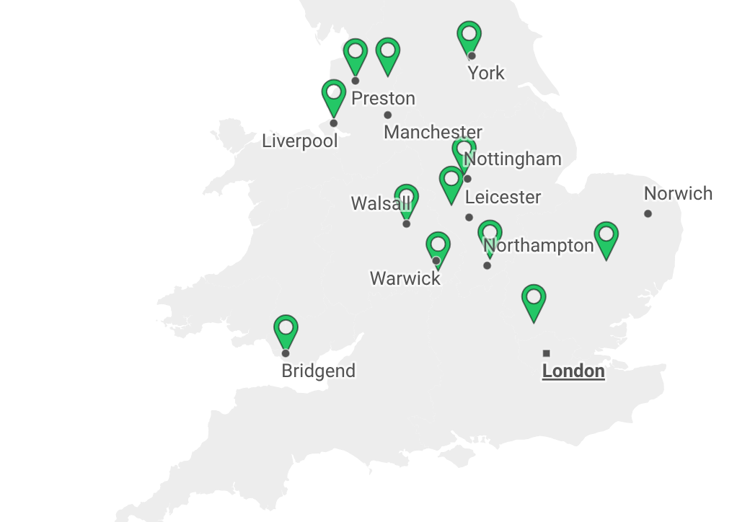
Purpose and Programme
Two-year pilot programme
To better align vocational education with workforce needs
To build stronger relationships between FE and employers
To ensure colleges equip students with work-ready skills that home builders and contractors need
To develop a digital toolkit to steer future employer engagement
Improve and increase student transition into the industry
Evaluate positive outcomes and collect best practice e.g. types of interactions taking place, number of learners who benefit

Slide 6

Programme Activities
Providing materials for students to use in workshops
Delivering employer led masterclasses in workshops
Curriculum mapping and working with tutors
Organising site visits and work experience opportunities
Supporting career fairs

Slide 7
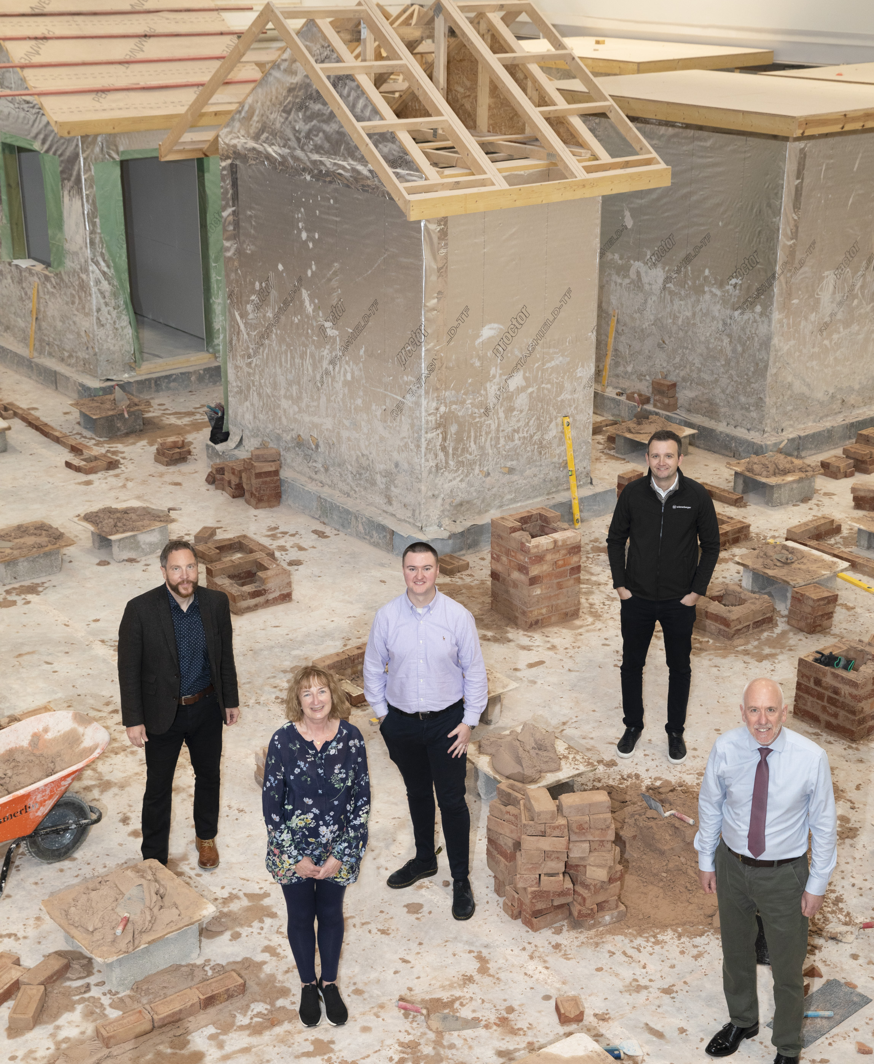

To date
12 Colleges, 10 Home Builders and 3 suppliers in the pilot
Interim evaluation completed
Dual Professional Model in progress

Slide 8
Dual Professional Model

Slide 9
A targeted pilot project designed to address the shortage of tutors and assessors in Further Education Building confidence for participants in both classroom and workshop settings Comprehensive support package, including funded training and employer subsidies for time away from work Agreed schedule of activity developed collaboratively with participating colleges

Slide 10
Paul Curry
Head of Training, Persimmon Homes PLC Supporting Skills Development – College Partnerships

Slide 11
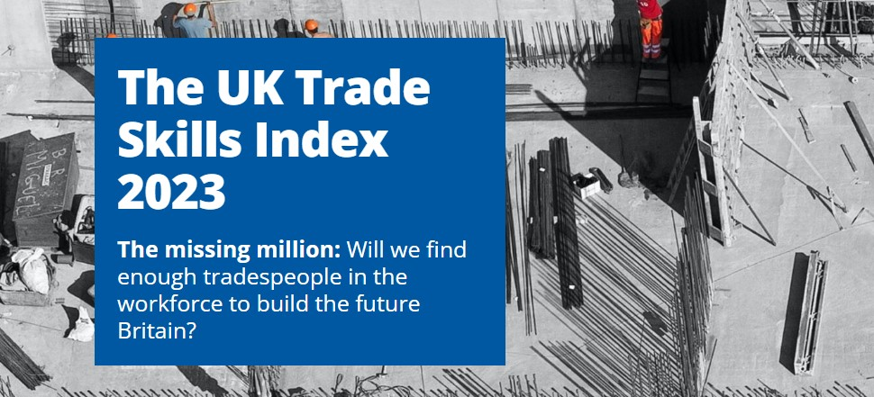
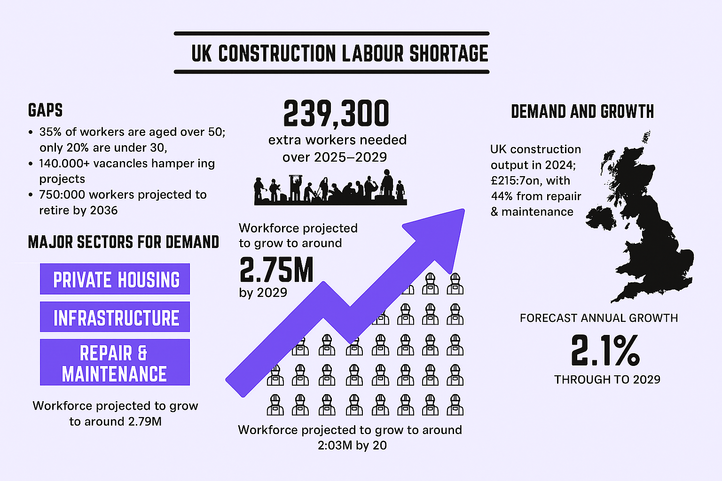
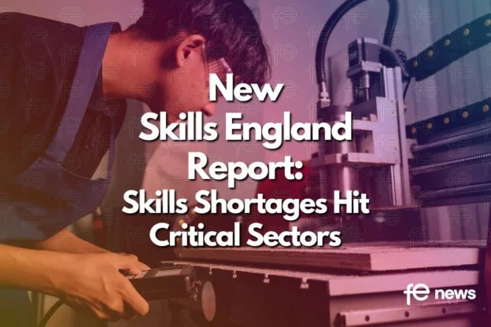

Why this matters.
Notes:
“If the construction industry wants to solve its skills shortage, the answer isn’t on our building sites — it’s sitting in college classrooms today.”
Pause 1 second
“And the question for all of us in this room is simple… are we connected strongly enough to that pipeline?”
I started working with the CITB in 2000, and the very first conversations I had with employers were about skills shortages.
A quarter of a century later, we’re still having the same conversation.
Pause 1 second
In that time we’ve seen a financial crash, a global pandemic, major changes to apprenticeships, and huge technical advances in construction — but the skills challenge remains.
And if we look at the data over the last 25 years, four things become very clear.
First, apprentice numbers have never significantly increased. Despite growth in housing demand and construction activity, the industry is still recruiting roughly the same number of apprentices today as it was around the year 2000.
Second, the 2008 financial crash created a lost generation of construction workers. During that period many companies stopped recruiting apprentices, training collapsed, and thousands of young people never entered the industry. On top of that we had the blip caused 2020 pandemic.
Those individuals should now be the experienced trades, supervisors and assistant site managers that we rely on to services our sites today.
Instead, that cohort simply doesn’t exist in the numbers we need.
Third, the workforce is ageing rapidly. Twenty-five years ago only about 13% of the workforce was over 55. Today that figure is closer to a quarter of the industry and constantly growing, meaning a large proportion of experienced workers will retire in the next decade.
And fourth, the apprenticeship system has become more complex. Where once many contractors relied on managing agencies, today the responsibility sits largely with the employer.
For many small businesses — the lifeblood of our industry — navigating that system can be difficult. So they need confidence they have quality candidates to make their investment in.
When you combine these four factors, you start to understand why the industry is struggling to find, experienced trades, supervisors, and future site leaders.
This is where college partnerships become strategically important.
They allow us to influence the front end of the talent pipeline, before people even become apprentices.
Through partnerships with colleges we can,
introduce students to construction earlier
support lecturers with real industry input
provide site visits and placements
help shape the curriculum around real skills
and create a clear pathway from college into apprenticeships and employment.
In simple terms, college partnerships help us rebuild the pipeline that the industry lost. For companies like Persimmon, they are not just about recruitment — they are about long-term workforce sustainability.
We need to meet an ever increasing housing demand, and increasing regulatory pressure that means the skilled and competent people we need in the industry tomorrow are sitting in college classrooms today. And as an industry if we are not connected to that pipeline now, we will continue to feel the skills shortages in the future.

Slide 12
What Does a Strong College Partnership Look Like?
Notes:
When we talk about strong partnerships between colleges and employers, it’s about far more than apprenticeships or recruitment pipelines.
I’d like you to take a moment and think back to when you were 16 or 17 years old.
You’re sitting in a classroom… maybe not entirely sure what the future holds… maybe wondering what direction life is going to take.
Now imagine someone from industry walks into that room.
Someone who works in the real world of construction… and they stand there and say:
‘You can do this. There is a place for you in this industry.’
Not because they had to be there… but because they chose to invest their time in you.
That moment — that belief — can change how a young person sees their future.”
That’s what real partnership looks like.
It’s employers helping colleges bring the real world of construction into the classroom, offering site visits, industry talks, career insight, and identifying and supporting future apprentices.
It’s working together to ensure the curriculum reflects the skills the industry actually needs, supporting mock interviews and employability workshops, even donating materials so students can practise their craft.
And just as importantly, it’s about recognising achievement and celebrating the next generation coming into our industry.
Because sometimes the most powerful thing we can give a young person… is simply our time and belief in their potential.”
And when colleges and employers genuinely work together, that belief turns into real opportunities, real careers, and real futures.
At Persimmon we’ve been fortunate to work with some fantastic colleges across the country, building partnerships that support learners and strengthen the skills pipeline for our industry.
So let me show you a few examples of what those partnerships look like in practice.”

Slide 13
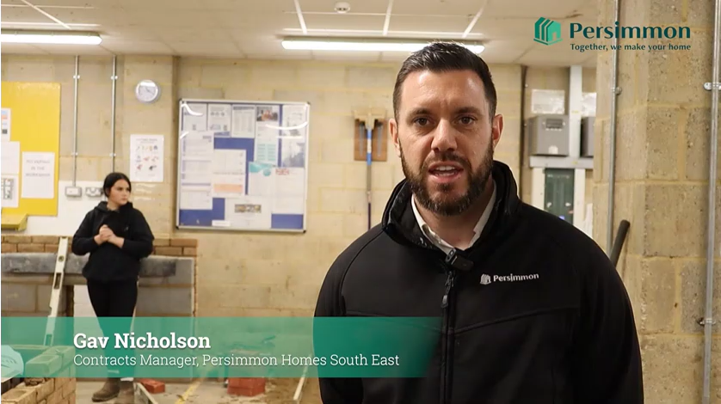
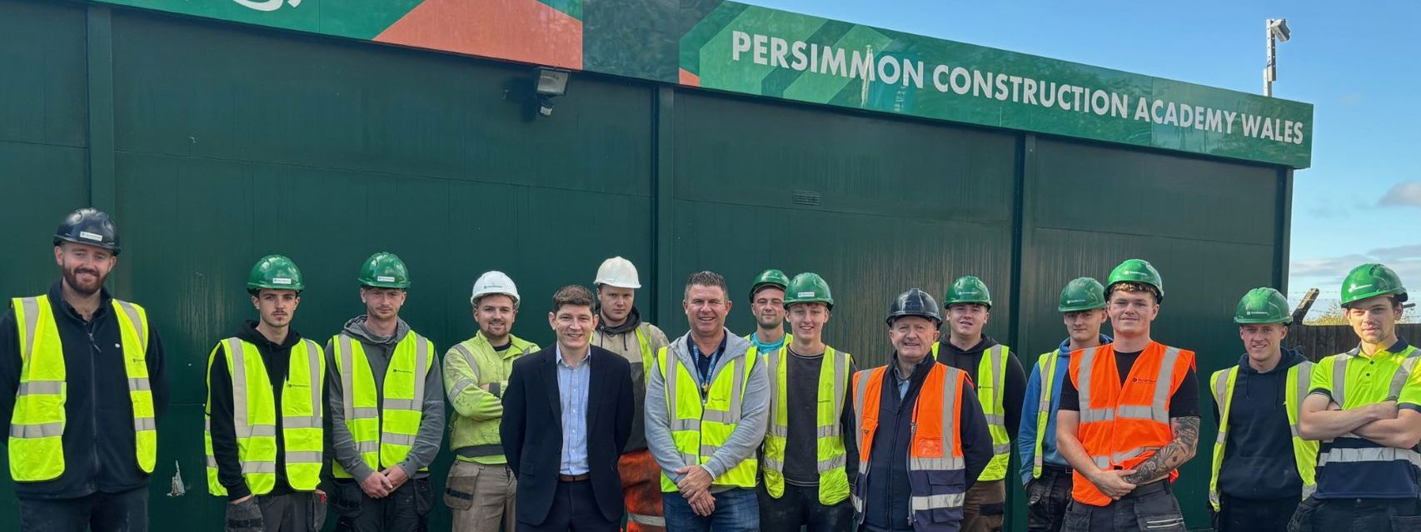
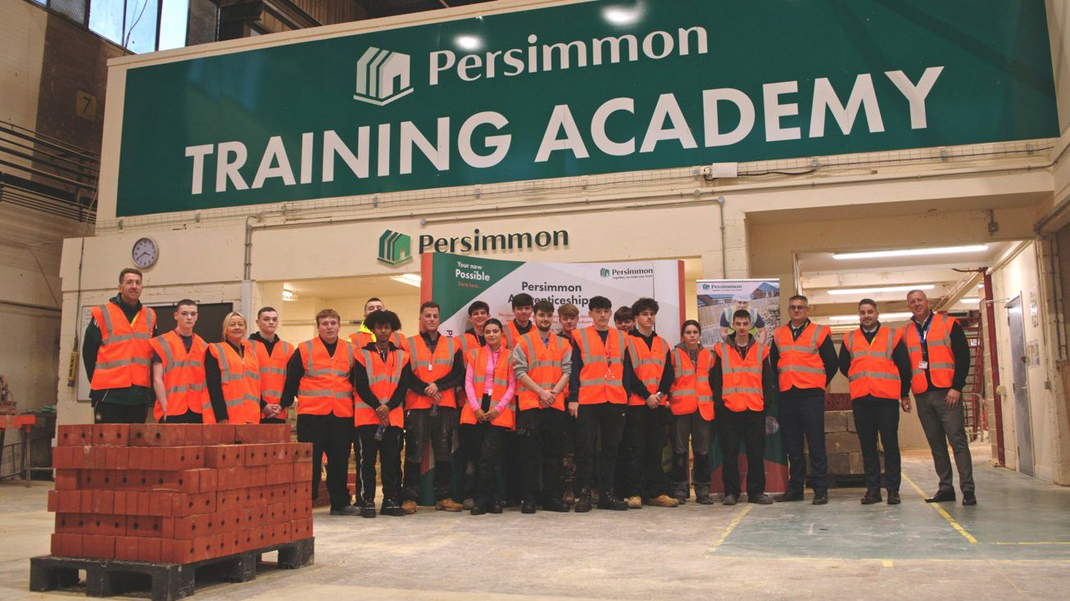
Example Partnerships
Notes:
One example of this in action is the Persimmon Newcastle Academy, a partnership between Persimmon Homes and Newcastle College designed to help develop the next generation of construction trades in the North East.
The academy provides industry-aligned training for our apprentices in trades such as bricklaying, joinery and roofing, but it also allows the college to combine college learning with direct employer engagement to give young people a clear pathway into construction.
We’ve recently expanded this with a new scholarship programme named after our founder Duncan Davidson, which provides young people not in education or learning with a structured vocational training route supported by a weekly bursary to help remove financial barriers.
What makes this partnership particularly powerful is the wider support network — working alongside the college, the Persimmon Charitable Foundation and community partners such as Newcastle United, to ensure young people are supported not just academically, but personally and professionally.
And what really brings this to life is seeing the individuals behind it.
Young people who may never have considered construction as a career are now gaining skills, confidence and progressing into apprenticeships with our business
Another great example of partnership is our work with Bridgend College through the Persimmon Bridgend Academy which has created more than 150 job opportunities for people in Wales over the last five years.
The programme supports learners with practical, industry-aligned training in an environment close to site conditions and gives them direct engagement with our regional teams.
One of the real successes has been seeing full-time college students progress into apprenticeships with our business, helping raise the aspirations of young people and showing them that a long-term career in construction is genuinely achievable.”
And its not just about these larger partnerships even the smallest interactions can bring big benefits so here’s a quick video to show this in action action. (2 minute video)
What these partnerships prove is that when colleges and industry collaborate, we don’t just train students — we open doors to careers and futures, providing opportunities, that might otherwise never happen.

Slide 14
The Mutual Benefit Model
Colleges Gain | Persimmon/Industry Gains | Students Gain
Employer insight | Talent pipeline | Real industry insight
Placement opportunities | Job-ready apprentices | Site exposure
Relevant curriculum | Fewer skill gaps | Employer-aligned skills
Industry credibility | Strong local presence | Career awareness
Student progression | Retention & loyalty | Clear career pathways
Notes:
One of the reasons college partnerships work so well is that everyone benefits.
For colleges, it brings valuable employer insight, placement opportunities and helps ensure the curriculum stays aligned with the skills our industry actually needs.
For Persimmon, it helps us build a strong talent pipeline, bringing in apprentices who already understand the expectations of working in construction and reducing the skills gaps we see across the sector.
But most importantly, the biggest beneficiaries are the students. They gain real industry insight, exposure to live construction environments, and a clear understanding of the career pathways available to them.
It improves employability by helping learners understand workplace behaviours, productivity and professional standards from day one.
And just as importantly, it builds confidence and a sense of belonging — helping young people see they are part of a bigger industry.”
And that combination of education and real-world experience helps young people enter the industry with the skills needed to succeed.”

Slide 15
Building the Future Together
Construction Needs
More homes Skilled trades Competence workforce Talent Pipeline
Further Education Needs
Strong learner outcomes Clear career destinations Employer engagement Positive progression data
Industry + Education = A Shared Challenge
Notes:
The reality is that both industry and further education are trying to solve related challenges.
Housebuilders need skilled people to build the homes the country requires.
Colleges want to ensure learners achieve and progress into meaningful careers.
When those two objectives align, strong partnerships naturally follow.”
But strong partnerships require commitment from both colleges and industry.
If we want to solve the construction skills challenge, colleges and industry cannot work in isolation.
So what can you do as an FE provider. You can
• Engage openly with industry on learner readiness • Align training with real site expectations • Support employability and workplace behaviours
And for those of us in industry what we Must Do is
• Bring real experience into the classroom • Provide placements and apprenticeship pathways • see this not as a cost but an Investment in developing the next generation
Because ultimately this isn’t just about training people.
It’s about building the homes the country needs, supporting communities, creating social mobility, preserving vital trade skills, and developing the workforce that will build the future.”
At Persimmon, we’re proud to play our part in that journey — working with colleges to help the next generation take their first step into the industry

Slide 16
The Future Workforce
Is sitting in college classrooms today!
Industry + Education = Building Futures Together
Notes:
This session today is about one simple truth.
The skilled people our industry will rely on tomorrow are sitting in school and college classrooms today.
If colleges and industry work together, we can open the door to these young people.
Because when we do… we’re not just building houses —
we’re building futures.”

Slide 17
Andrew King
FE Teacher Recruitment Policy Lead
Department for Education

Slide 18
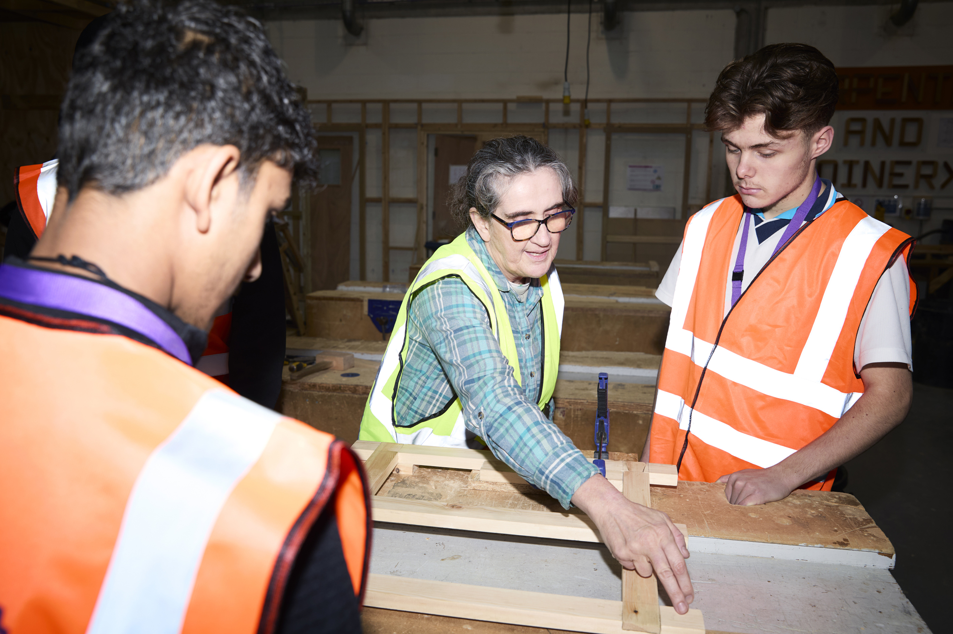


Industry Supporting Further Education: Developing the Future Home Building Workforce

Slide 19
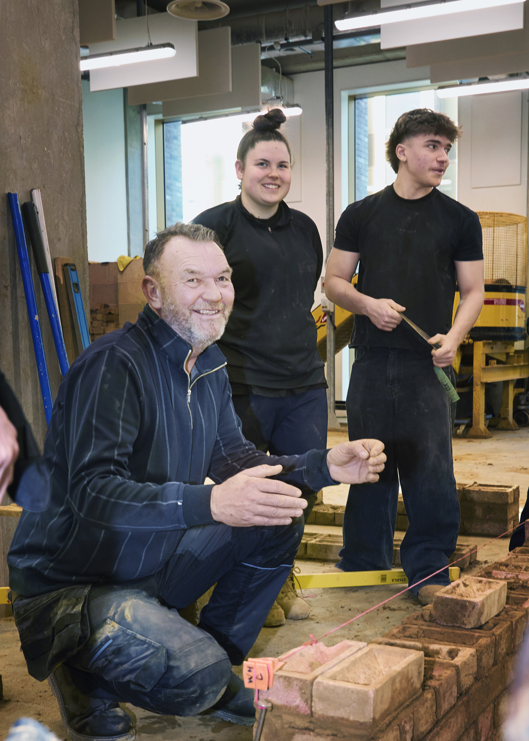
Coming up:
What Further Education (FE) is
What engagement in Further Education means for employers
What getting involved looks like for workers
Routes into FE teaching
Support available to help workers get started
Notes:
Your 10–15 minute talk is designed to give attendees a clear, accessible overview of how FE teaching and training can be a natural next step for experienced construction professionals, later‑career workers, or those seeking variety and purpose. The focus should be on flexible entry, on‑the‑job training, and how industry expertise strengthens FE delivery-without implying that individuals must leave home building roles to get involved.
Hello everyone, and thank you for joining.
I am really pleased to be here to talk about how Further Education and the home building sector can work together to support the next generation of skilled workers.
Today I want to highlight how your industry experience can make a direct impact in local colleges and how getting involved in FE is more accessible and rewarding than many people realise.

Slide 20

What is Further Education?
FE is education for learners aged 16 and over who aren’t in school or studying for a degree.
Delivered in colleges and training providers across technical, vocational and academic subjects. Practical, hands‑on learning: workshops, on-site, or anywhere that allows learners to get hands-on experience in their field.
A strong option for later‑career professionals seeking a less physical role that keeps them connected to their trade.
Notes:
Provides a straightforward overview of how FE teaching can become a natural progression for experienced or later career professionals. Explain on the job training, flexibility and part time pathways, without implying that worker must leave the sector to take part.
Further Education is for learners aged 16 and over who are not in school or studying for a degree. Colleges and training providers deliver a wide range of technical, vocational and academic subjects.
In construction, FE is especially practical and hands on. It includes workshops, on-site, or anywhere that allows learners to get hands-on experience in their field.
FE is also a strong option for later career professionals who want to stay connected to their trade in a role that is less physical but still highly meaningful.

Slide 21
What engagement in the Further Education sector means for employers
Build your future workforce with people trained to your standards
Influence the curriculum so colleges teach what your sites actually need
Develop your workers through real leadership, communication and mentoring experience
Retain valuable industry knowledge by giving later‑career workers meaningful development routes.
Raise your organisation's profile as a sector leader committed to skills development
Identify emerging talent early through direct contact with learners at local FE colleges

Slide 22
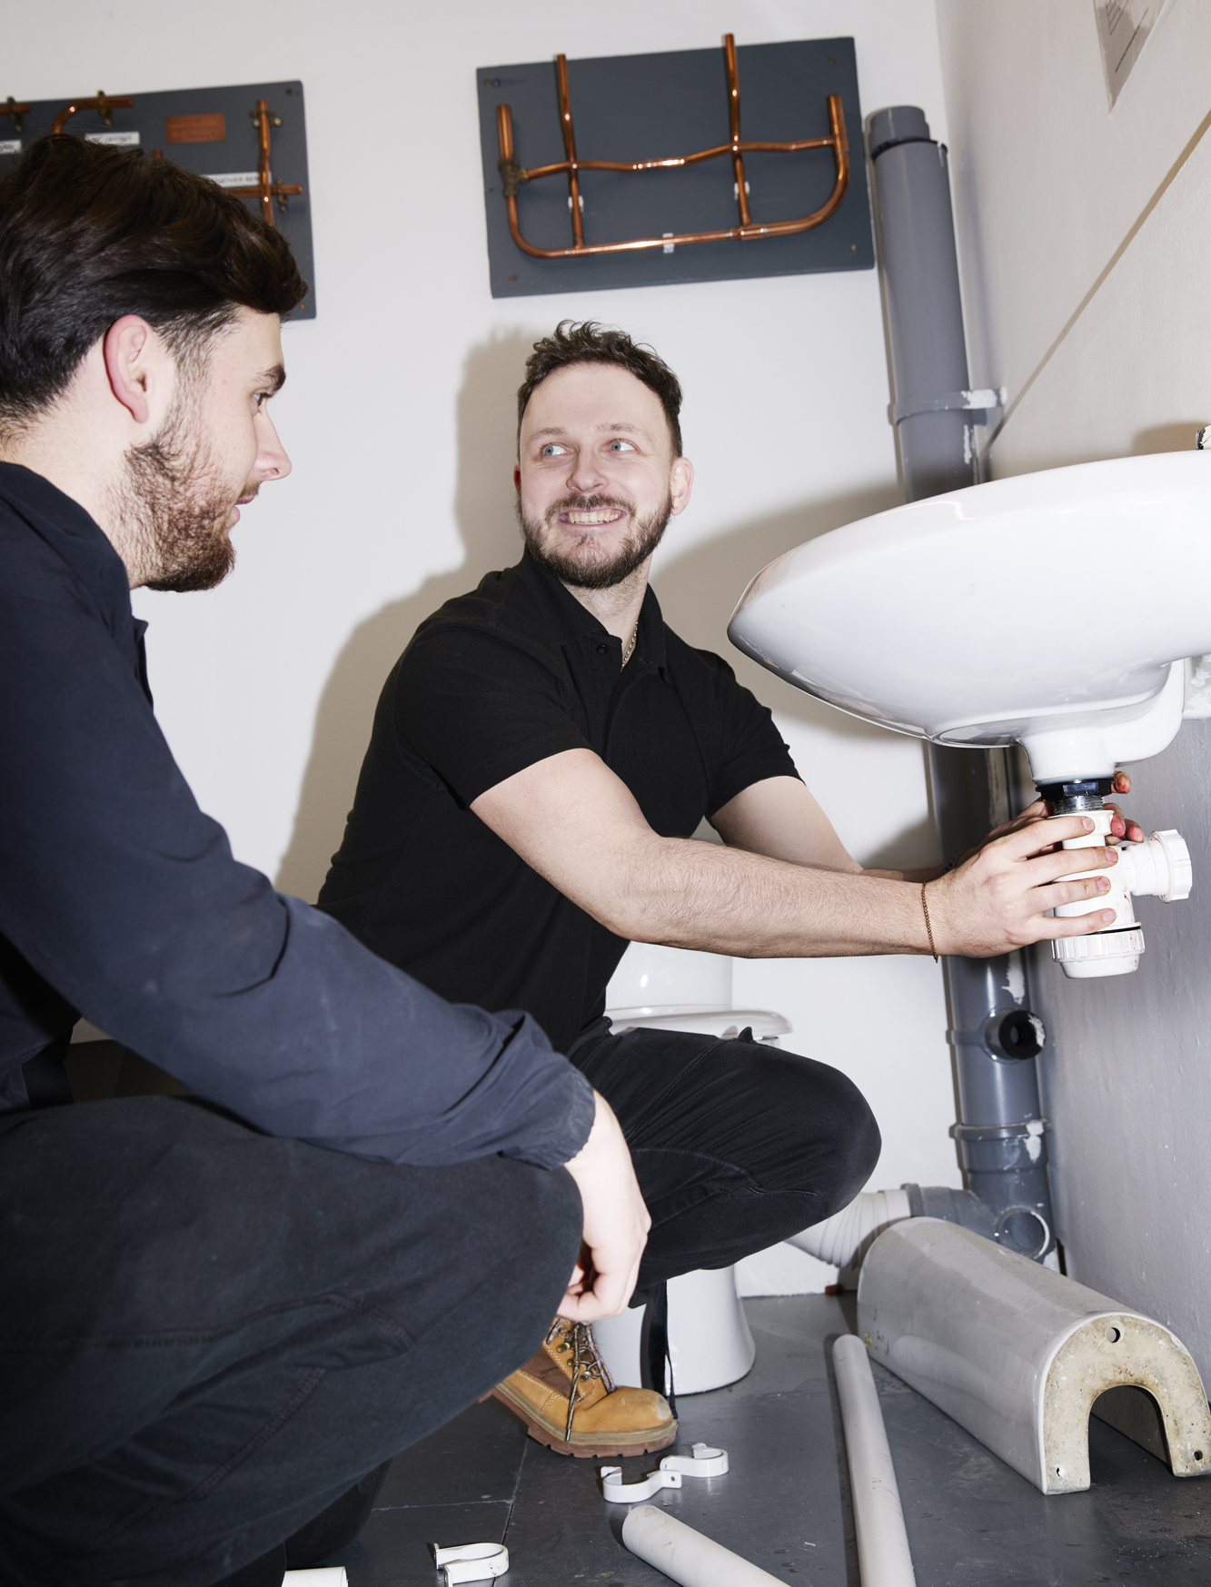
What getting involved looks like for workers
No new qualifications needed: Workers can start training others in FE straight away, and many colleges offer on‑the‑job teacher training so they can become fully qualified while earning.
Strengthening the sector: Workers share real‑world experience that helps prepare learners for work and ensures training reflects current industry needs.
Renewed career purpose: Training others at a local college can provide a fresh environment for workers to use long‑developed skills while staying connected to their trade.
Flexible opportunities: While most FE roles are full‑time, some part‑time and flexible options are available, enabling involvement to sit alongside existing work or personal commitments.
Notes:
There are several ways for workers to become involved in FE, and involvement can begin without the need for new qualifications. Workers who already have real industry experience possess the knowledge and insight colleges are looking for, and many providers offer on‑the‑job training so individuals can begin contributing while developing their teaching skills.
Industry experience plays a valuable role in preparing learners for work. Workers understand the standards, behaviours and expectations required on site, and this insight helps ensure FE training reflects what the sector genuinely needs. Their contribution strengthens the future workforce by bringing real practice into the learning environment
For many workers, taking part in FE activity can bring a renewed sense of purpose and energy. It provides the opportunity to apply long‑established skills in a fresh setting, while still remaining connected to their trade and the work they know well.
Most roles in FE are full‑time, though some part‑time and flexible opportunities do exist. This allows involvement to fit around existing work or personal commitments where appropriate, giving workers options that suit their circumstances.

Slide 23
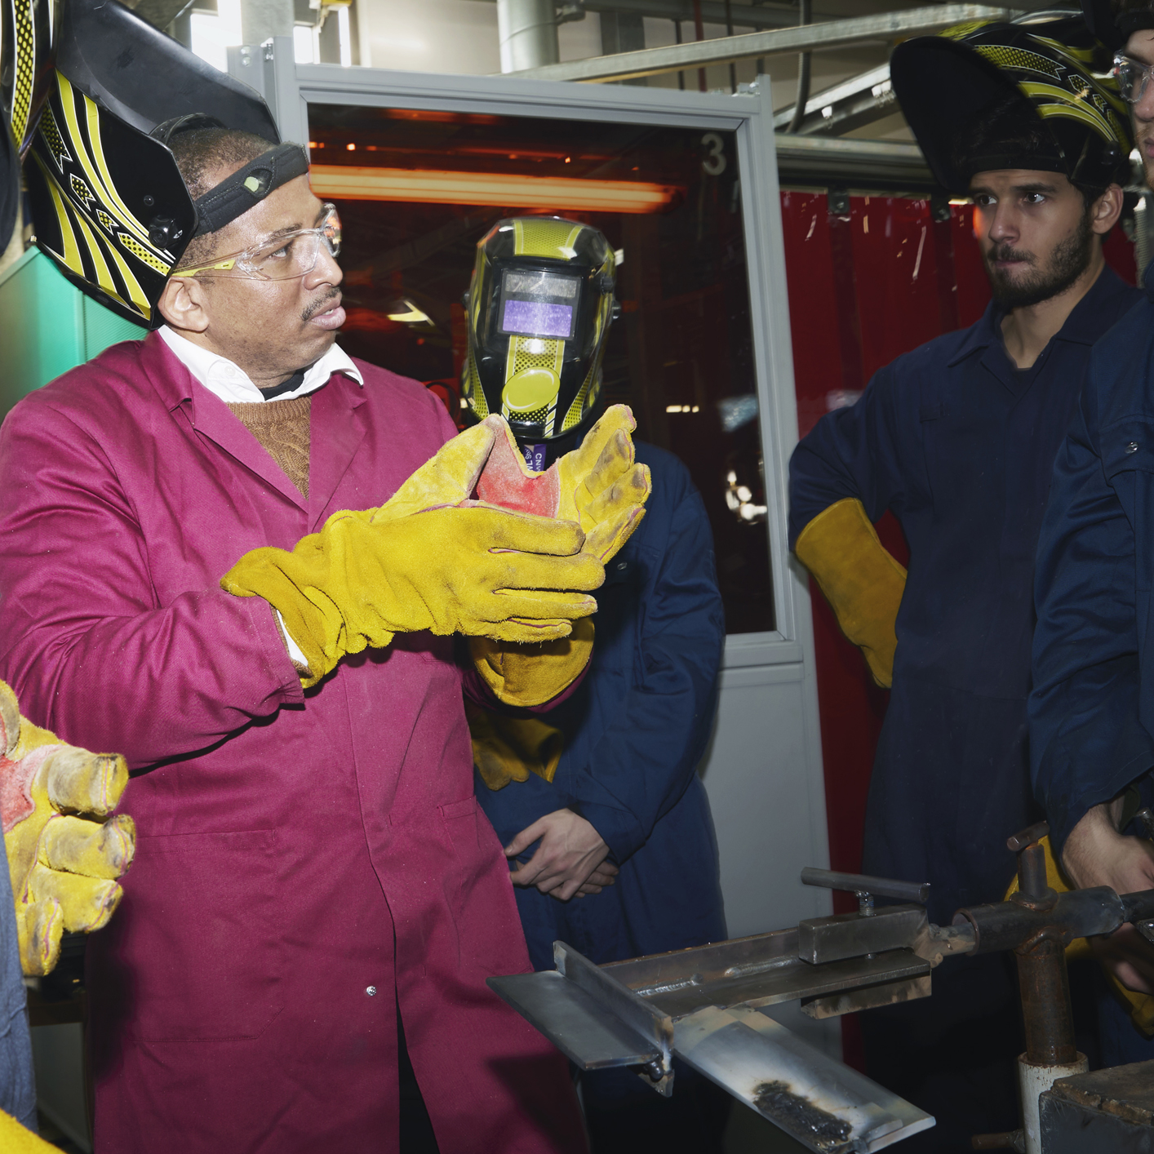
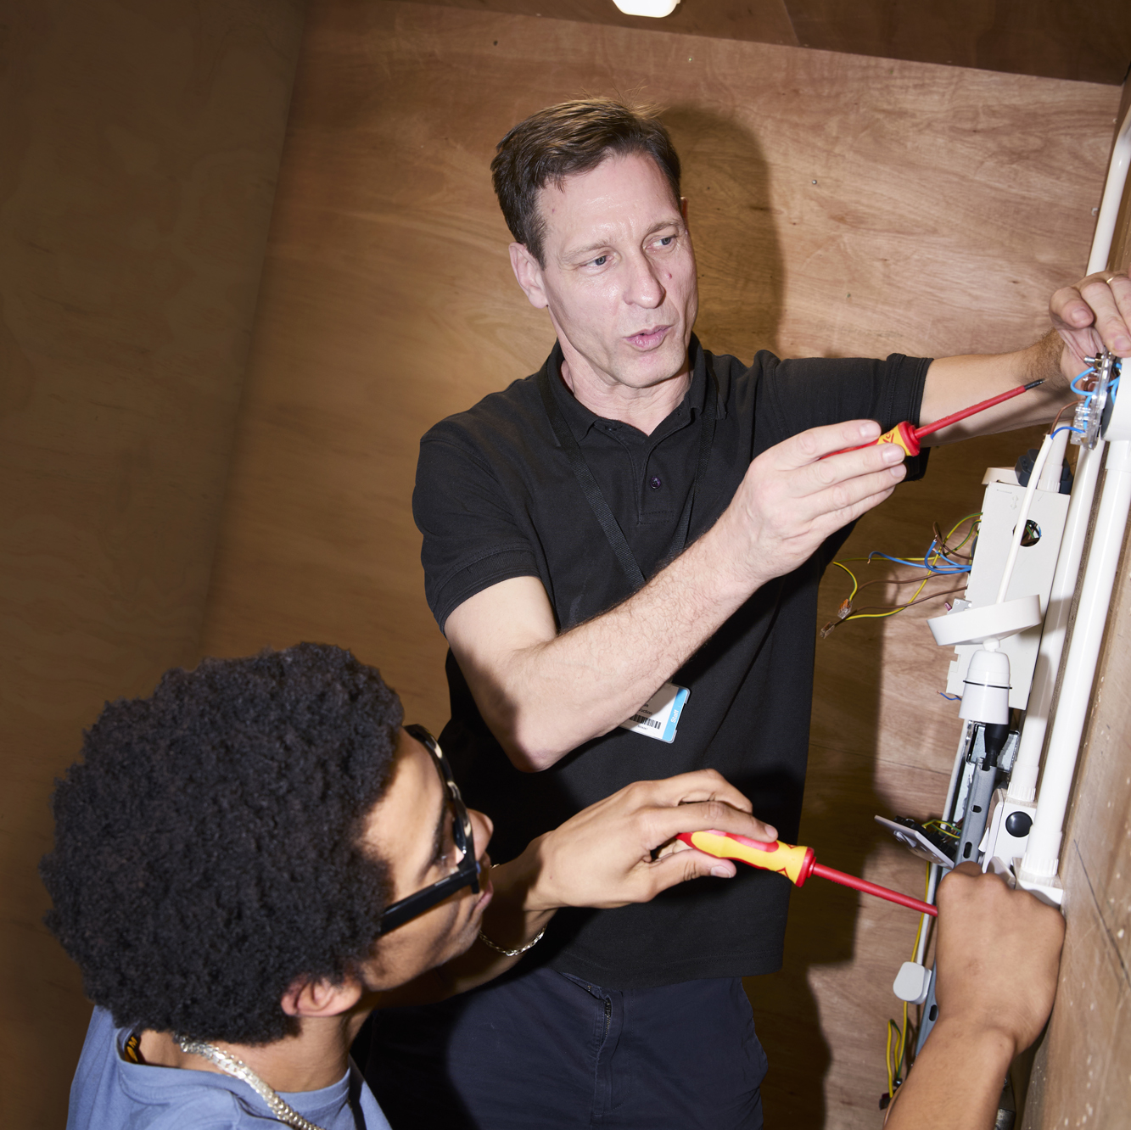
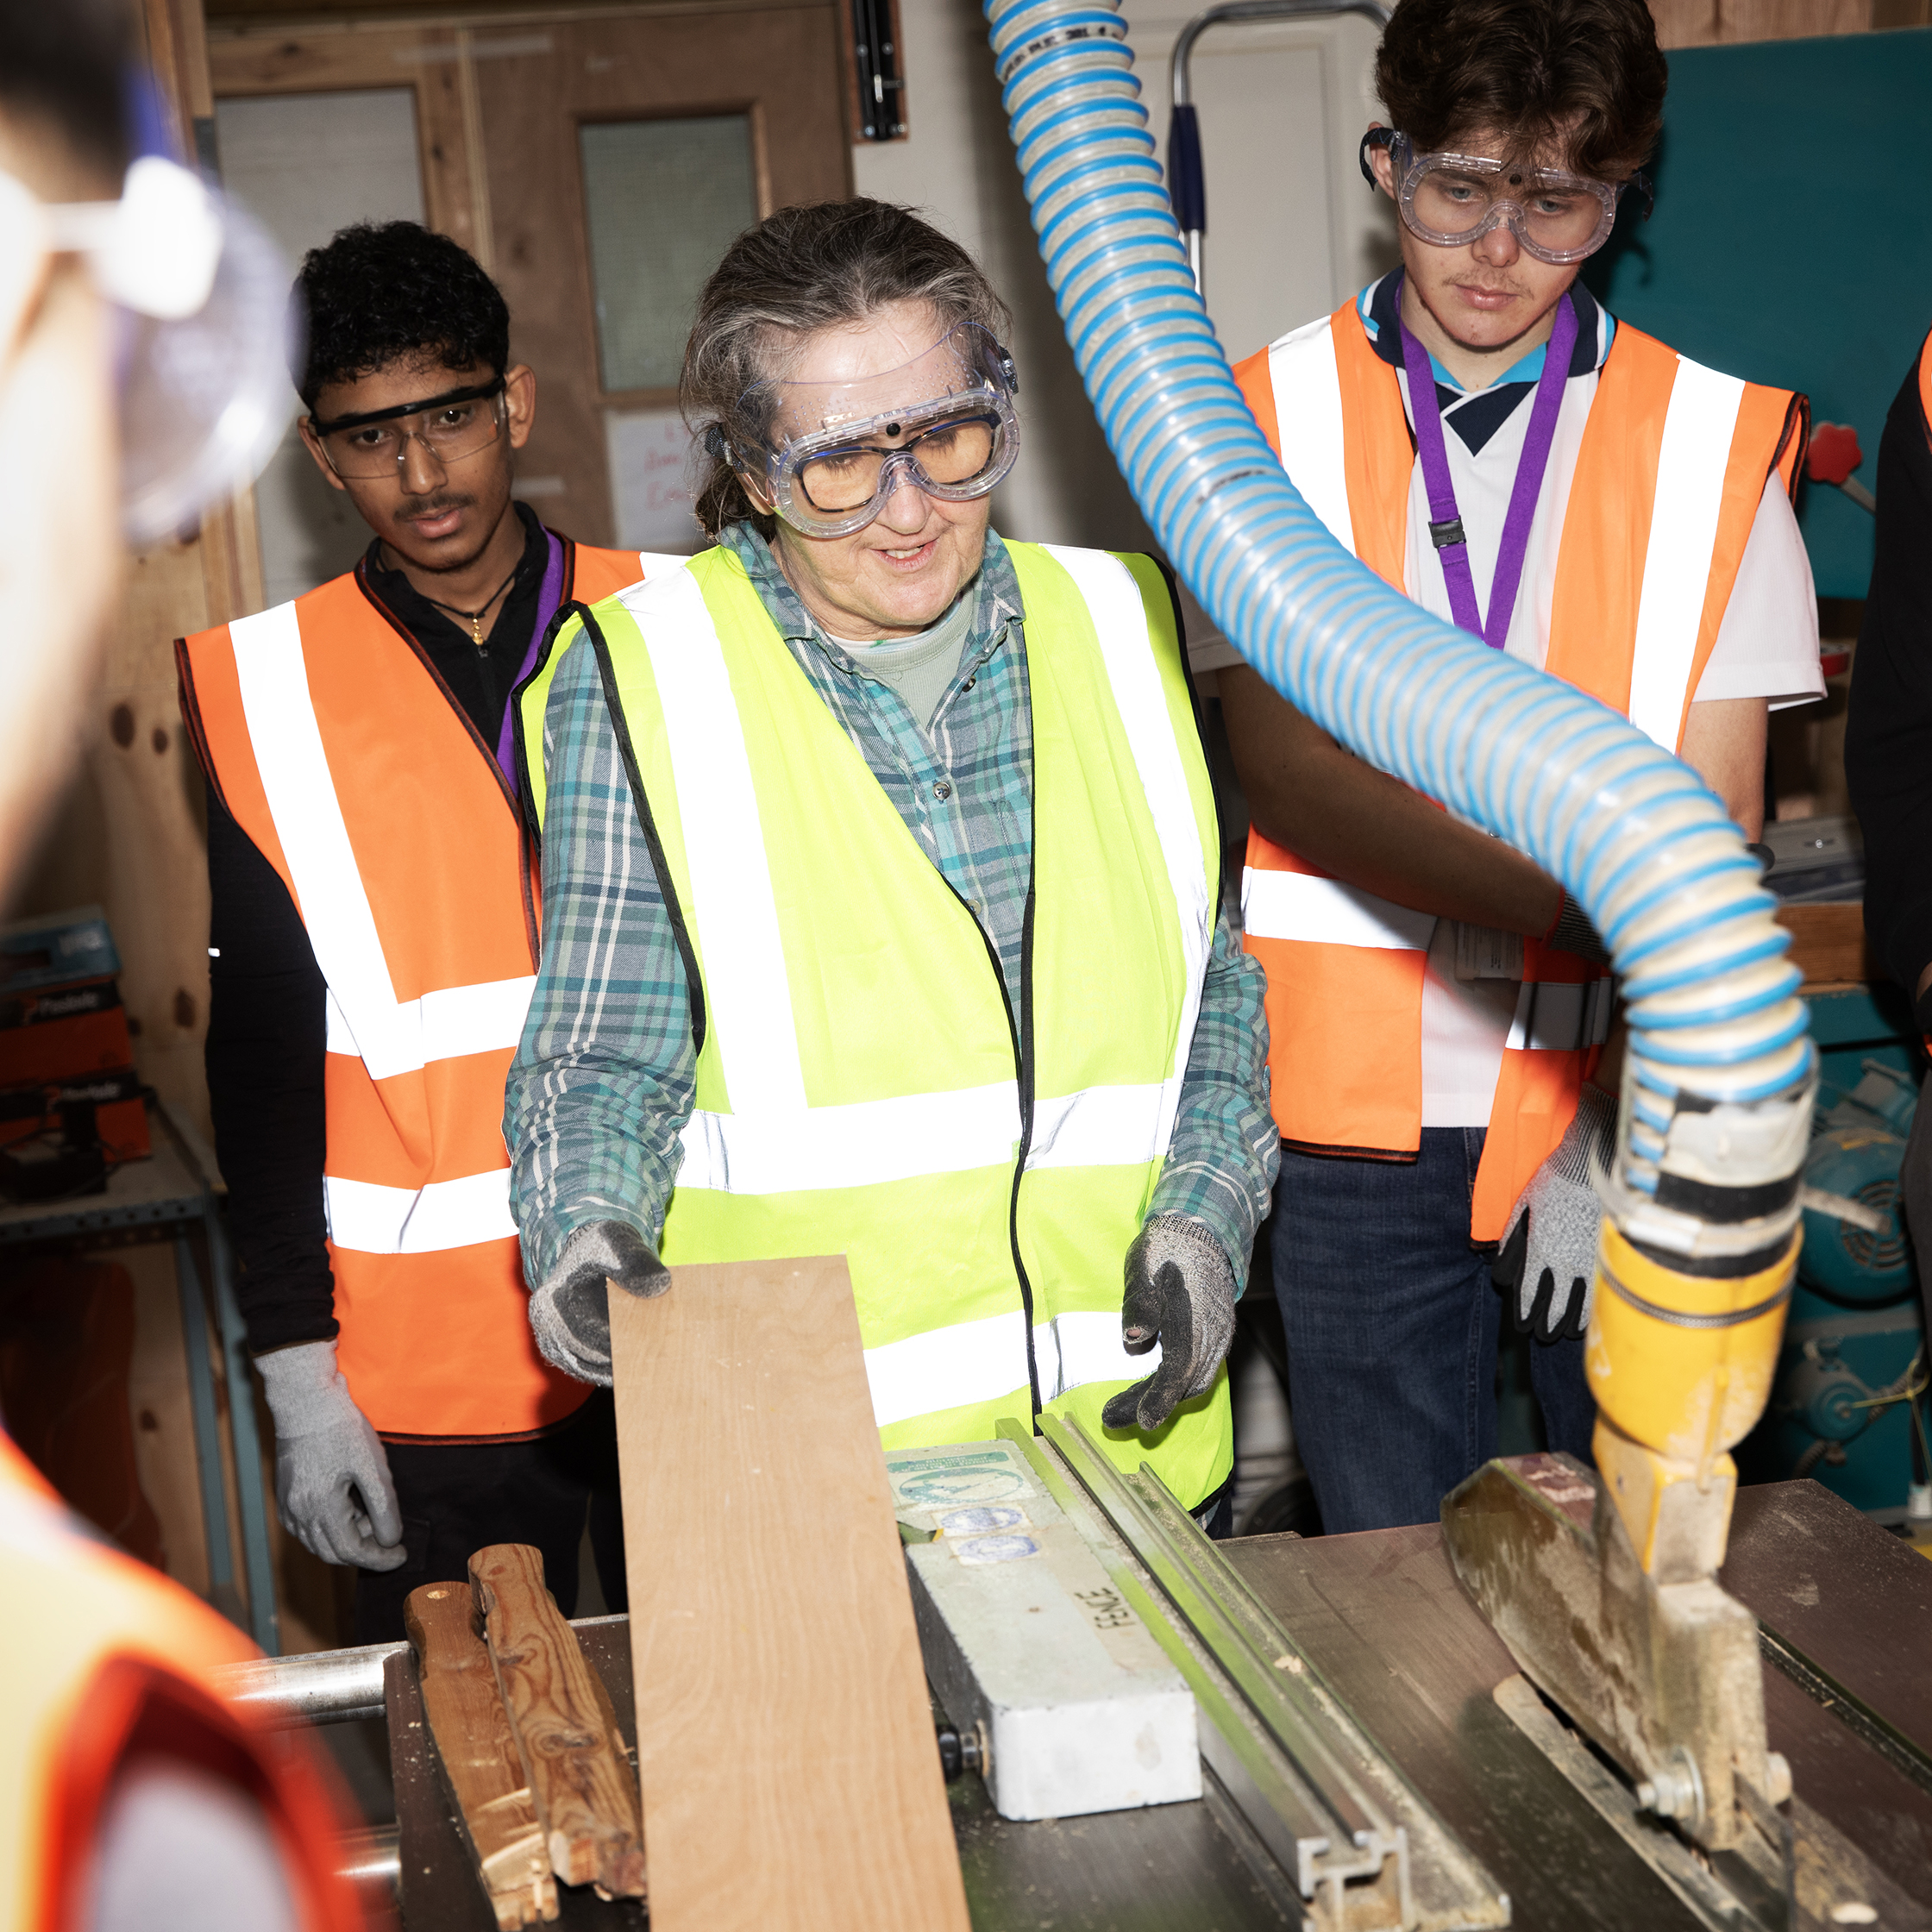
Routes for your workers to train others in FE​
Research jobs and apply
Train on the job
Get a teaching qualification
Notes:
The route into FE teaching can be flexible.
Research jobs and apply:​
Workers can look for roles on college websites or job boards. Roles may be titled lecturer, tutor, trainer or skills coach.
Train on the job:​
Depending on the provider, training may take place on the job while earning, or through qualifications taken independently. On‑the‑job training allows worker to begin sooner, while training independently may offer access to bursaries.
​​
Get a teacher qualification:​
Providers will advise on required qualifications. Requirements vary, and sector experience is often the key factor FE providers seek.

Slide 24
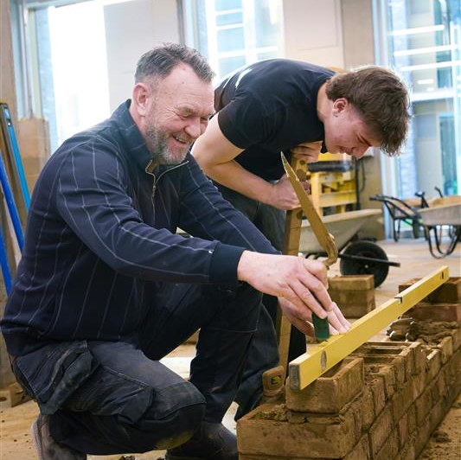
Support available
Support from official channels
Visit: gov.uk/teach-in-further-education
Phone: 0800 389 2502 (Mon–Fri, 9am–5.30pm)
Email: teach.FE@education.gov.uk
Support from specialist FE advisors
Get personalised guidance
Understand routes and training options
Help finding roles that match worker skills
Try it out first
Contact local FE providers and enquire whether they could offer work experience or shadowing experience
Notes:
Train others in Further Education website
The Teach in FE website brings together clear information on what FE is, who can train, and how workers can get started.
It includes practical guidance, examples from people already involved, and links to opportunities at local colleges.
Support Service
Specialist FE advisers are available to guide workers through the different routes into FE.
They can answer detailed questions, help identify suitable roles, and provide personalised support as individuals explore their options.
Not sure if teaching in FE is right for you?
Workers do not need to decide straight away.
Local colleges may be able to offer shadowing or short work‑experience opportunities, helping individuals understand what FE involvement looks like in practice.
Employers can encourage worker to explore these introductory steps if they wish to learn more.

Slide 25
Thank you.

Slide 26
Hugh Baird College
Neil Dolan and Scott Brown

Slide 27
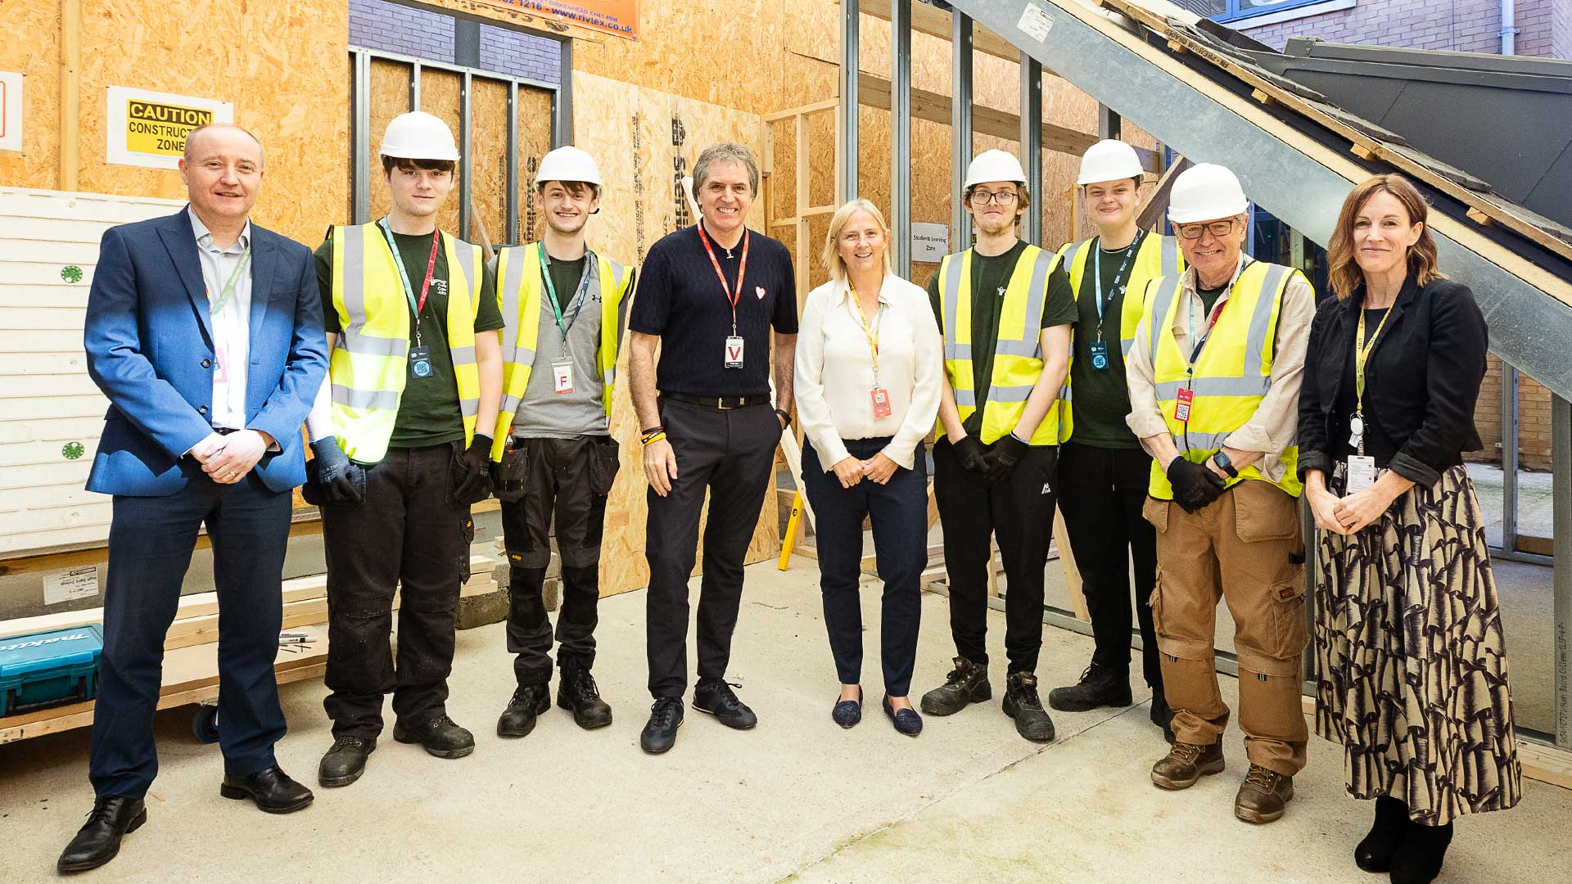
Hugh Baird Facilities
Replicating Industry: Modular Build
Hugh Baird College offers state of the art facilities, in order to best prepare students for industry. Some of these facilities include:
A modular build facility whereby students can gain a realistic experience of working on a housing project. Some activities which are completed in this space would include aspects of 1st fix, 2nd fix and finishing joinery, as similar as possible to what site joiners would work on day to day.
Kitchen fitting and bathroom fitting is also practiced in this space, allowing students studying different trades to work collaboratively together in accordance with a plan of works. This prepares students for benefits and challenges which they will come up against when working on site.

Slide 28
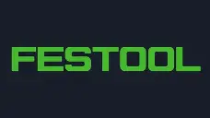


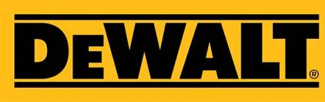
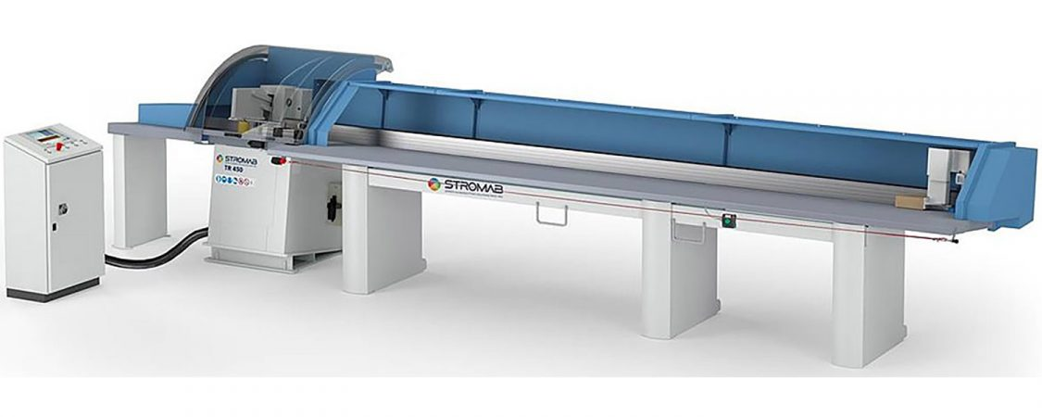
Tools and Equipment Available
Highest Standard of Equipment
Hugh Baird College aims to give students the best experience possible when studying a trade.
Including a CNC Stromab Machine, CNC Spindle Moulder, CNC Thicknesser, CNC wall saw. A comprehensive range of Festool, Dewalt, Makita and Milwaukee Portable Power Tools available for use. As well as this, a brand new Chain Morticer and framing table to best replicate what students will be using in modern insustry, teaching methods used in off-site manufacture.
As well as this Hugh Baird College offers both internal and external training on modern industry machinery.

Slide 29
Some Courses Offered Which Lead Onto House Building
Led by experienced tutors with trade background
Carpentry and Joinery
Level 1 Diploma
Level 2 Site Diploma
Level 3 Site Diploma
Multi Skills
Level 2 Architectural Joinery
Plumbing
Plumbing level 1
Plumbing Level 2
Plumbing and Domestic Heating Level 3
Electrical Installations
Electrical Installations Level 1
Electrical Installations Level 2
Electrical Installations Level 3
Wet Trades
Bricklaying Level 1
Bricklaying Level 2
Plastering Level 1

Slide 30
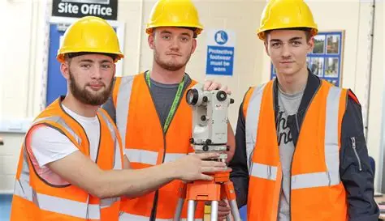
Professional Construction
Progression to Higher Education
As well as offering courses in trade subjects, Hugh Baird College also offers T-Level Foundation Year in Construction, as well as T-Level Design, Surveying and Planning in Construction.
This course prepares students for a career in professional construction/progression to apprenticeship or higher education.
These courses have high rates of progression onto Degrees/Degree Apprenticeships within the Buit Environment.
This aims to target the demand for UK construction professionals.

Slide 31

Alternative Construction Courses
Short Courses and Evening Courses
As well as studying on a full-time course in Hugh Baird, there is also an opportunity for adult learners to embark on a career within the Construction Industry.
There is a Construction DIY course offered at Hugh Baird college, with an option to study during the daytime or of an evening. This course teaches the fundamental skills to carry out basic DIY, as well as giving individuals the opportunity to progress onto a full-time course at Hugh Baird College.
This short course is offered to Adults within the Liverpool City Region, without a fee.

Slide 32

Questions

Slide 33
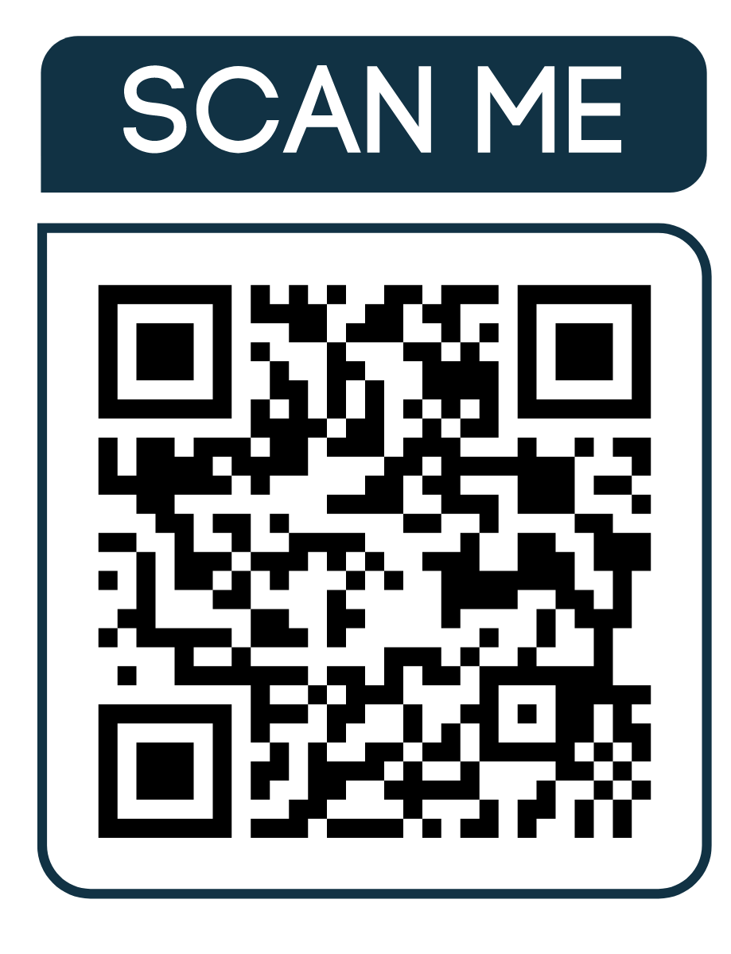
Thank you for joining us
Follow us on LinkedIn: the-home-builders-federation
And X: @HomeBuildersFed
Feedback on today’s session and recommendations for future sessions: comms@hbf.co.uk
Scan the QR code to view future events

Slide 34


The voice of the home building industry.
hbf.co.uk | 0207 960 1600 | @homebuildersfed

