Slide 1
Understanding changes to UK waste crime and enforcement

Slide 2

Rhodri Williams
Technical and Sustainability Director
Home Builders Federation

Slide 3
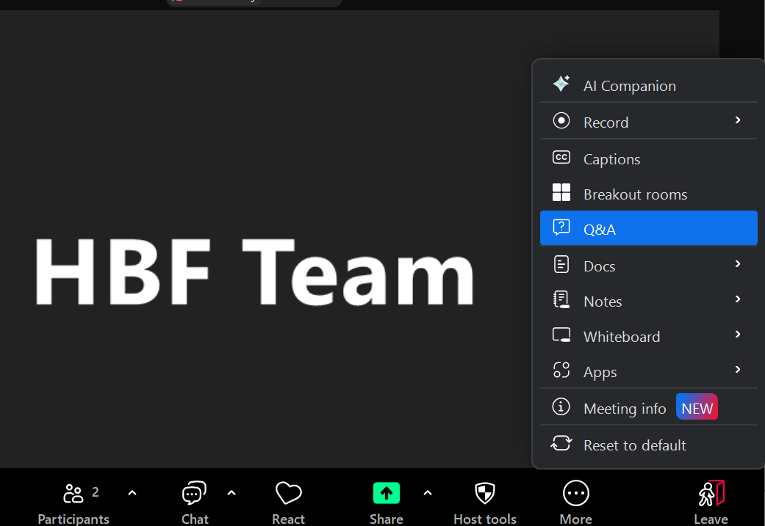
Housekeeping slides
One hour session, with time at the end for Q&A
Feel free to pose questions throughout the session via the Q&A function, instead of chat
A recording of the session will be circulated and made available on the HBF website.

Slide 4
Will Rundle
CEO
Nexus ReGen

Slide 5
HBF WEBINAR · 11 JUNE 2026
Waste Crime:
Your Risk,
Waste compliance has changed.
Your Capital
Do you know
your exposure?
Will Rundle
CEO, Nexus ReGen
Nexus ReGen | Nexus Assurance | nexusregen.com

Slide 6
Today's Session
01
The regulatory shift
What has changed and why it matters now
02
Your legal exposure
Duty of care, liability and what the law actually requires
03
The supply chain blind spot
Where most organisations have their biggest gap
04
The financial consequences
What non-compliance actually costs in hard numbers
05
The minimum standard
What a compliant housebuilder looks like in practice
06
Nexus Assurance
The compliance platform built for this problem
Nexus ReGen | Nexus Assurance | nexusregen.com
20-minute session

Slide 7
SECTION
The Regulatory
Shift
Waste compliance is now a financial crime issue.
01
Nexus ReGen | Nexus Assurance | nexusregen.com

Slide 8
The scale of the problem
£1bn
20%
estimated annual cost of waste
crime to the English economy
of all waste in England is
illegally managed (EA, 2025)
3+
£150m
illegal waste sites stopped
every working day for 18 months
(1,205 total, July 2024 – Dec 2025, EA)
in Landfill Tax revenue lost to
evasion in 2023/24 alone (HMRC)
Nexus ReGen | Nexus Assurance | nexusregen.com
Section 01, The Regulatory Shift

Slide 9
What has changed, and when
The foundations: how waste crime became a financial enforcement priority
1996
Landfill Tax introduced, licensed sites only
Rate: £7/tonne. Illegal sites paid nothing, giving rogue operators a direct cost advantage. For its first 22 years, the tax created no liability for illegal site operators or the supply chains feeding them.
2016–17
First dedicated government funding to tackle waste crime
Budget 2016: additional HMRC funding for compliance activity across the waste supply chain. Autumn Budget 2017: further funding to both EA and HMRC. First formal acknowledgement that existing enforcement resource was insufficient. (Source: OBR Landfill Tax page)
2018
Finance Act 2018, HMRC enters the supply chain
From 1 April 2018, Landfill Tax extended to unauthorised sites. Rate at time: ~£88/tonne. HMRC given power to pursue anyone in the supply chain who caused or facilitated illegal disposal. Supply chain penalty: up to 100% of the tax liability on top.
2020
JUWC launched, NCA, HMRC, EA and police under one operation
January 2020. The National Crime Agency becomes a founding partner in waste enforcement. The infrastructure for coordinated, multi-agency financial crime investigation is formally in place. Waste crime is now treated as serious organised crime.
Sources: Finance Act 1996; Finance Act 2018; OBR Landfill Tax page; GOV.UK JUWC launch press release January 2020. Continued on next slide.
Nexus ReGen | Nexus Assurance | nexusregen.com
Section 01, The Regulatory Shift (1 of 2)

Slide 10
What has changed, and when
The acceleration: £50.6m committed, enforcement at scale, October 2026 changes everything
2024
EA Economic Crime Unit launched, waste crime formally becomes financial crime
5 February 2024. A dedicated unit targeting the financial proceeds of waste crime under POCA 2002, not environmental breaches, the money. Two teams: Asset Denial (freeze and seize) and Money Laundering Investigations. 26 active investigations and 42 confiscation orders secured since launch. (Source: GOV.UK press release, February 2024)
2025
£50.6m government commitment, rate surges 21.6% in a single year
Budget 2025/26: £5.6m enforcement uplift, more than 50% increase on the prior year's budget. Plus £45m committed over the following three financial years. Total new commitment: £50.6m. Rate April 2025: £126.15/tonne, the largest single-year increase in a generation, adjusted for accumulated inflation 2022 to 2024. (Source: GOV.UK Waste Crime Action Plan March 2026; OBR)
2026
Today, £130.75/tonne, 43 new staff operational, DWT mandatory October
Standard rate £130.75/tonne from 1 April 2026. Lower rate more than doubled to £8.85/tonne, largest uplift to that rate in a decade. 43 new frontline criminal enforcement staff operational this financial year. Digital Waste Tracking mandatory for all permitted receiving sites from 1 October 2026. The EA will receive a live digital feed of every waste movement into every permitted facility in England, no tip-off, no site visit required. (Source: GOV.UK; HMRC; Waste Crime Action Plan)
Sources: GOV.UK EA Economic Crime Unit press release February 2024; GOV.UK Waste Crime Action Plan March 2026; OBR Landfill Tax page; HMRC Landfill Tax rates; Digital Waste Tracking (England) Regulations 2026.
Nexus ReGen | Nexus Assurance | nexusregen.com
Section 01, The Regulatory Shift (2 of 2)

Slide 11
You are already visible.
Seven ways enforcement finds you, before October 2026 adds an eighth that operates automatically at scale.
01
Supply chain contamination
02
ANPR vehicle tracking
Your carrier or disposal site is investigated. Investigators request producer records as standard. You are pulled into an investigation you didn't start, your records determine your position.
Since April 2022, the EA has had access to the National Automatic Number Plate Recognition Service. Vehicles travelling to known illegal sites or on routes inconsistent with declared destinations are flagged automatically. (Source: EA blog, February 2024; Clyde & Co, 2024)
03
Financial intelligence, HMRC cross-referencing
04
Satellite and drone surveillance
Disposal costs anomalously low vs market rates trigger review. Landfill Tax declarations are cross-referenced against EA permit data and WTN records. Discrepancies between declared and recorded movements initiate investigation.
The new Operational Waste Intelligence and Analysis Unit uses satellite imagery and drone surveillance to identify illegal site activity, volumes deposited, timing, site patterns. No site visit required to build the intelligence picture.
05
Whistleblowers and Crimestoppers
06
Planning and permit scrutiny
The EA has worked with Crimestoppers since 2013. Reports from competitors, former employees, site neighbours and the public are actively sought. 16,773 reports of suspected waste crime recorded in England in 2023 and 2024 alone. (Source: EA heatmap, July 2025)
Applications for planning consent or environmental permits increasingly trigger compliance record checks. For developers with active planning pipelines, non-compliance in waste management creates a direct operational risk beyond the enforcement exposure.
07
EA and HMRC direct records requests
08
Digital Waste Tracking, October 2026
OCT 2026
A formal EA records request gives you not less than 7 days to respond. HMRC can request records as part of a Landfill Tax investigation. Without a centralised, retrievable compliance record, the response is manual, incomplete and indefensible.
From 1 October 2026, every permitted receiving site logs your waste digitally in real time. The EA receives a live data feed. Volume anomalies, EWC mismatches and permit breaches surface automatically, no tip-off, no visit, no warning.
Nexus ReGen | Nexus Assurance | nexusregen.com
Section 01, The Regulatory Shift

Slide 12
The enforcement architecture has changed
The infrastructure has been in place since 2020, what has changed is the resource
The Joint Unit for Waste Crime launched in January 2020, bringing EA, HMRC, the National Crime Agency and police forces under one coordinated enforcement operation. It has always existed. What is new is what is being put into it.
43 new frontline enforcement staff added in 2025/26 alone
The 2025/26 budget uplift directly funds 43 additional frontline criminal enforcement staff across the JUWC and EA area environmental crime teams. This is not a future plan. These people are operational now.
The output: more than three sites stopped every working day
From July 2024 to end of 2025, the EA shut down 1,205 illegal waste sites and secured 122 prosecutions including 10 immediate custodial sentences. That is more than three sites every single working day for eighteen consecutive months. (EA direct enforcement figures, separate from JUWC joint operations.)
EA Economic Crime Unit, launched February 2024
Dedicated unit investigating the financial proceeds of waste crime under POCA 2002. Not environmental breaches, the money. 26 active money laundering investigations. 42 confiscation orders secured since launch.
Intelligence-led targeting: they already have the picture before they arrive
New Operational Waste Intelligence and Analysis Unit combining satellite imagery, drone surveillance, financial data and criminal intelligence. This is proactive identification of targets, not reactive response. By the time enforcement visits, the investigation has already started. Your records are your defence.
Nexus ReGen | Nexus Assurance | nexusregen.com
Section 01, The Regulatory Shift

Slide 13
SECTION
Your Legal
Exposure
Duty of care. The law does not care who you hired.
02
Nexus ReGen | Nexus Assurance | nexusregen.com

Slide 14
Duty of care: what the law requires of you
Section 34, Environmental Protection Act 1990
Anyone who produces, carries, keeps, treats or disposes of controlled waste carries a statutory duty of care. As a housebuilder, every waste movement from your sites is within scope from the moment waste is generated.
You must
prevent
You must
verify
You must
evidence
Unauthorised deposit, treatment or disposal of waste, and escape of waste from your control.
That waste is transferred only to a registered carrier, and that it goes to a facility permitted to accept that specific waste type.
That you took reasonable steps, even when the package is subcontracted. The duty does not transfer with the contract. You need a mechanism that gives you assurance the work is being done compliantly.
You cannot contract out your duty of care. You can delegate the activity. You cannot delegate the obligation to evidence it.
Nexus ReGen | Nexus Assurance | nexusregen.com
Section 02, Your Legal Exposure

Slide 15
Knowingly cause or knowingly permit
Environmental Permitting Regulations 2016, Regulation 38
What the law says
Where HMRC and the EA focus
An organisation does not need to have directly committed the offence to be liable.
EWC code accuracy
Misclassified codes are the primary mechanism of Landfill Tax evasion. Accepting a WTN without checking EWC code accuracy is undisclosed liability.
If it knowingly caused or knowingly permitted non-compliant activity, it is exposed.
Waste Transfer Note assurance
A WTN filed on receipt provides no protection if it goes unchecked. Reasonable steps requires a demonstrable process for assurance. HMRC's scrutiny of EWC misclassification is a separate and sharper exposure.
Delegation to a subcontractor does not extinguish liability. It requires you to evidence that you exercised oversight.
Landfill Tax joint liability
Absence of oversight does not reduce risk. It creates it.
From April 2018, those who cause or facilitate disposal at an unauthorised site share the tax liability. Standard rate: £130.75 per tonne.
Nexus ReGen | Nexus Assurance | nexusregen.com
Section 02, Your Legal Exposure

Slide 16
SECTION
The Supply Chain
Blind Spot
Most organisations have a policy. Very few have evidence.
03
Nexus ReGen | Nexus Assurance | nexusregen.com

Slide 17
Ask yourself, right now
Can you confirm the final destination of every waste movement from every active site?
Are Waste Transfer Notes being validated, or simply filed on receipt?
Do you have a process to verify EWC code accuracy, and does your supply chain know you apply a zero trust policy on classification?
Are waste carrier licence registrations being verified, and monitored for expiry?
When a carrier, broker or disposal facility changes, is that change captured and approved?
Are records stored centrally, or distributed across site managers and email inboxes?
If the Environment Agency issued a formal records request today, could you respond within a defensible timeframe?
Nexus ReGen | Nexus Assurance | nexusregen.com
Section 03, Supply Chain Blind Spot

Slide 18
The risk profile by organisation type
SME Developer
Regional Housebuilder
National PLC
Low volume, high exposure
Risk compounds across sites
Strategic and reputational exposure
Waste activity fully outsourced. No internal verification process. A single non-compliant movement can trigger Landfill Tax at £130.75 per tonne, joint enforcement and investigation, without prior warning.
Small site count does not mean small risk.
Multiple sites, multiple subcontractors, inconsistent documentation. Central policy exists but site-level application is uneven. Records are fragmented. This profile produces the failures most likely to go undetected until they surface in enforcement.
The compliance architecture exists. The gap is between central policy and site-level evidence. Investigations span years and hundreds of sites. Inability to produce an auditable chain of custody becomes a board-level disclosure event.
Nexus ReGen | Nexus Assurance | nexusregen.com
Section 03, Supply Chain Blind Spot

Slide 19
SECTION
The Financial
Consequences
What non-compliance actually costs, in hard numbers.
04
Nexus ReGen | Nexus Assurance | nexusregen.com

Slide 20
A single compliance failure: the worst case
Scenario: 5,000 tonnes declared as topsoil, sent to an unauthorised site
WORST CASE
Landfill Tax, standard rate £130.75/tonne applies to ALL material at an unauthorised site
£653,750
HMRC penalty, 100% of tax liability (deliberate and concealed case)
£653,750
EA enforcement, prosecution costs and legal defence (upper evidenced range)
£300,000+
Remediation and re-excavation ordered by EA, Devon floodplain precedent
£2,500,000+
Total worst case exposure
£4.1m+
Source: HMRC Landfill Tax guidance; Finance Act 1996 as amended; EA Devon floodplain enforcement case; GOV.UK prosecution cost data.
Nexus ReGen | Nexus Assurance | nexusregen.com
Section 04, Financial Consequences

Slide 21
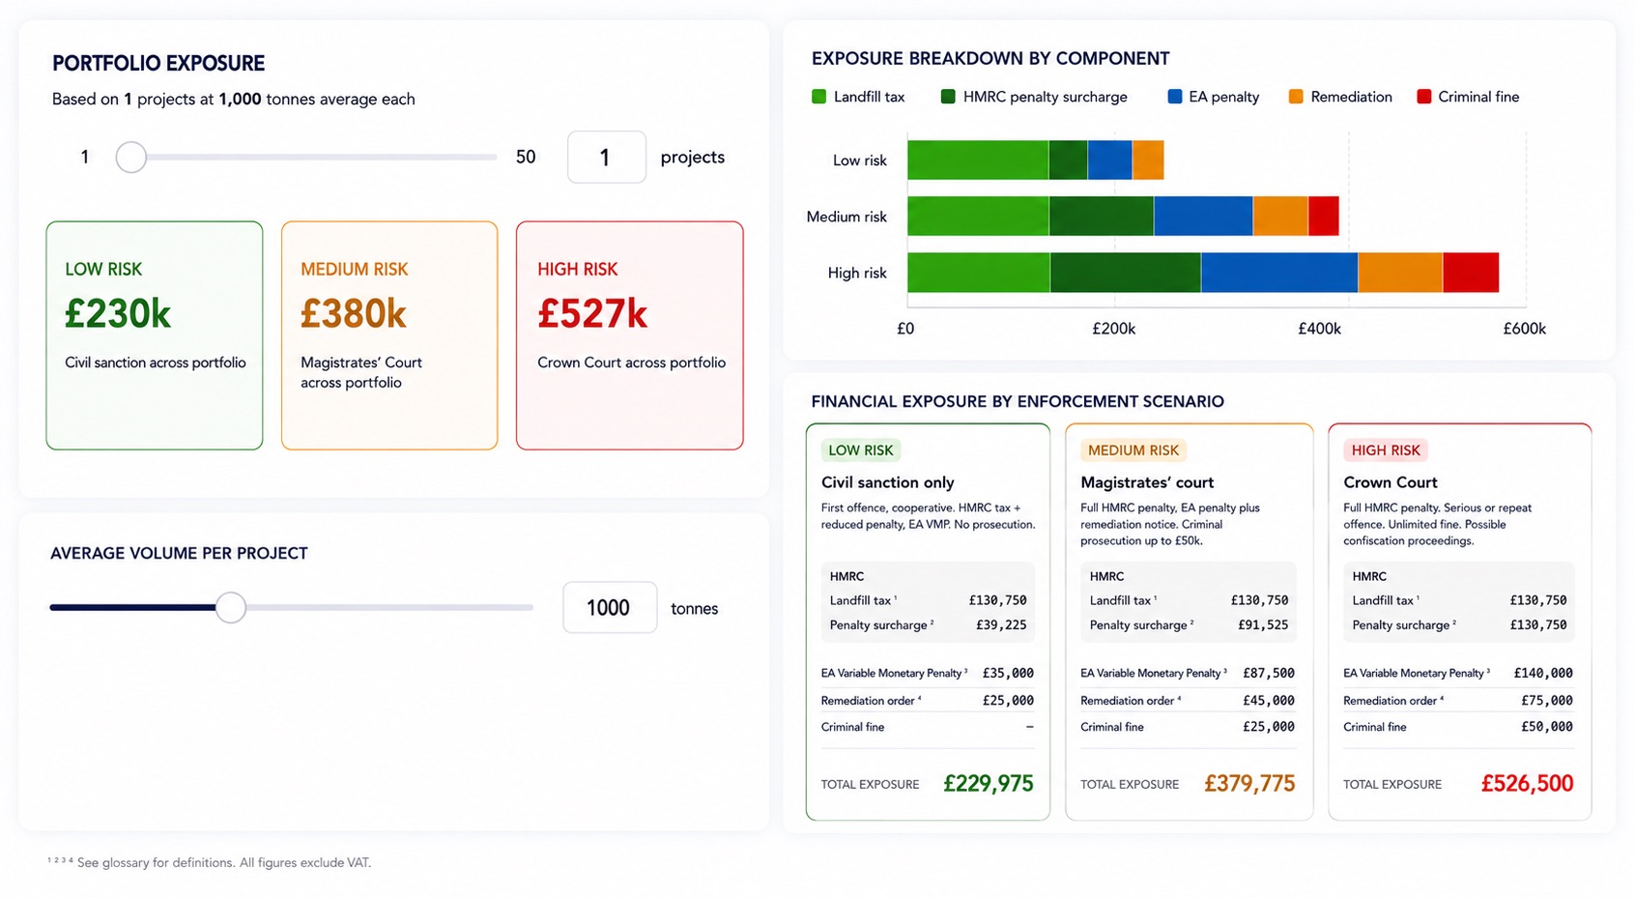
5,000 tonnes misrouted to an unauthorised site. Worst case.
Sources: HMRC Landfill Tax guidance; Finance Act 1996 as amended; EA Devon enforcement case; GOV.UK prosecution cost data.
Nexus ReGen | nexusregen.com
Nexus Assurance: The Financial Reality

Slide 22
How it actually happens
A real scenario. More common than most organisations would like to admit.
01
The subcontract
02
The great rate
03
The WTNs
04
The EA visit
A residential developer subcontracts the earthworks package to a trusted, well-used contractor. Standard practice. The subcontractor arranges the muck away independently, as they always have.
The haulier quotes a noticeably low price. The subcontractor accepts, it saves money and nobody asks why the rate is so competitive. An anomalously low disposal rate is a recognised red flag for unlicensed or illegal disposal activity.
Waste Transfer Notes are issued. Most are partially completed. Half carry the wrong EWC code, the material is coded as inert when it is not, or misclassified to access a lower disposal cost. Nobody checks. They are filed and forgotten.
The Environment Agency attends site and requests all Waste Transfer Notes. What they find: incomplete records, incorrect EWC codes, and a carrier whose licence expired three months ago. The investigation has already started. The developer is the waste producer on record.
The developer is the waste producer on every WTN. They did not arrange the disposal. They did not know the EWC codes were wrong. It does not matter. The duty of care sat with them from the moment the waste was generated on their site.
Nexus ReGen | Nexus Assurance | nexusregen.com
Section 04, Financial Consequences

Slide 23
Beyond the tax bill
Criminal prosecution
Asset recovery
Duty of care breaches under Section 34 EPA 1990 carry unlimited fines on conviction. On indictment: unlimited fine plus up to two years' imprisonment.
The EA Economic Crime Unit operates under POCA 2002. 42 confiscation orders secured since mid-2024. This trajectory is moving upward.
Reputational damage
Loss of supply chain control
For listed businesses, an EA or HMRC investigation is a disclosure event. Investor, lender and planning authority relationships carry implicit compliance expectations.
Once an investigation begins, regulators build their picture from the evidence they hold. Without your own auditable records, your position is weak regardless of intent.
Nexus ReGen | Nexus Assurance | nexusregen.com
Section 04, Financial Consequences

Slide 24
SECTION
The Minimum
Standard
What a compliant residential developer looks like in practice.
05
Nexus ReGen | Nexus Assurance | nexusregen.com

Slide 25
Duty of care checklist for residential developers
Verify waste carrier licence registration before engagement, monitor for expiry across your full carrier base
Store all WTNs, movement records and carrier documents in a centralised, retrievable system
Confirm the receiving facility is authorised to accept the specific waste type declared on the WTN
Ensure site teams understand duty of care obligations: not just that a policy exists, but how to apply it
Retain waste records for a minimum of two years, consider longer given the EA's investigative reach
Be able to respond to an EA records request without relying on subcontractors to supply your documentation
Nexus ReGen | Nexus Assurance | nexusregen.com
Section 05, Minimum Standard

Slide 26
SECTION
Nexus
Assurance
The compliance platform built for this problem. Already deployed across the sector.
06
Nexus ReGen | Nexus Assurance | nexusregen.com

Slide 27
You now know your risk.
The question is what you do about it.
Most organisations in this sector have a waste management policy. Very few have a system that produces the evidence to stand behind it.
AWARENESS
THE GAP
RETIREMENT
You know the regulatory environment has changed and the financial consequences are real.
Your policy exists. Your evidence does not. The supply chain is the blind spot.
Close the gap with a system that produces evidence, not just records movement.
Nexus ReGen | Nexus Assurance | nexusregen.com
Section 06, Nexus Assurance

Slide 28
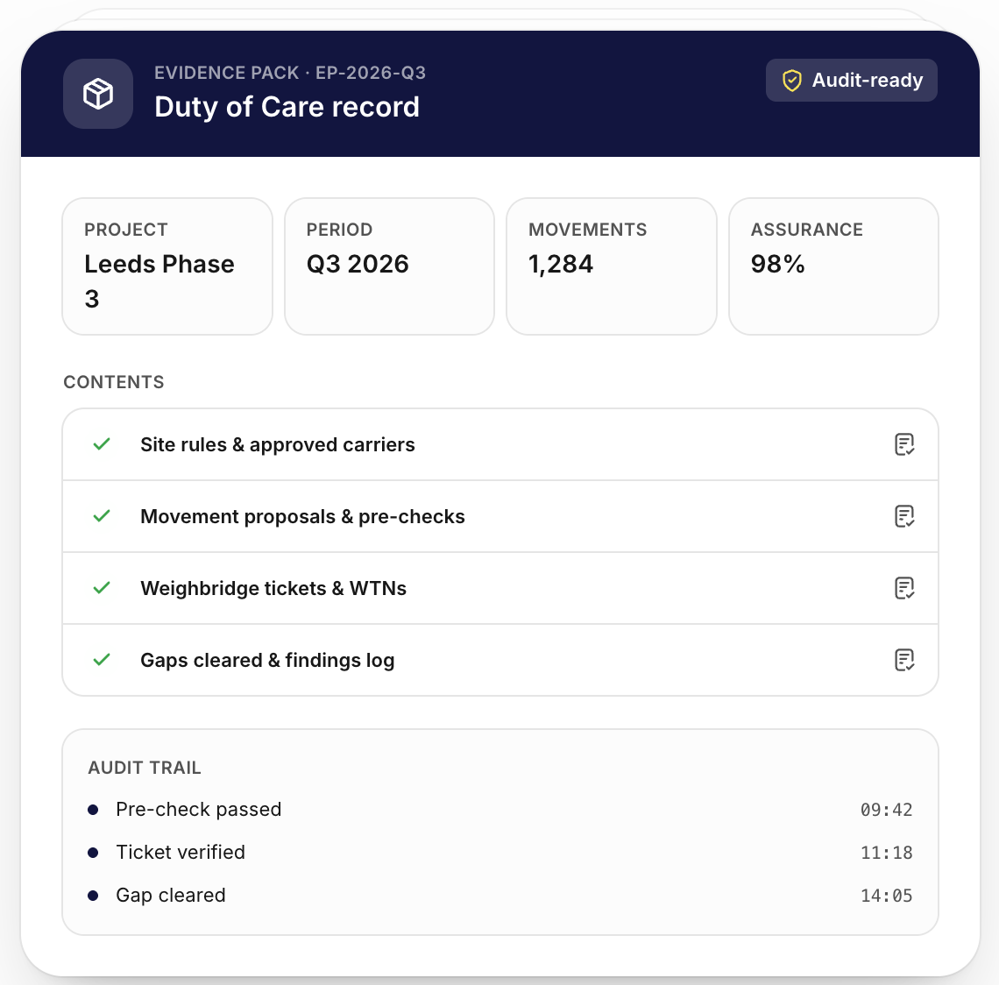
Nexus Assurance
A compliance platform.
Not a tracking tool.
Tracking tools record what happened. Nexus Assurance helps organisations evidence whether what happened was compliant, before, during and after every movement.
Add UI screenshot here
Sits above every other system
Suggested: dashboard or overview
Including DWT, carrier systems and site-level documentation. One centralised compliance layer, not another silo.
Built for the housebuilding supply chain
Designed for multi-site, multi-subcontractor operations with fragmented documentation and variable site-level compliance.
Already deployed at scale
In use across some of the largest residential developers and housebuilders operating in the UK today.
Nexus ReGen | Nexus Assurance | nexusregen.com
Section 06, Nexus Assurance

Slide 29
Duty of care: the legal standard vs the leading standard
Section 34 EPA 1990, Reasonable Steps
Zero Trust Supply Chain, The Leading Standard
Subcontracting the waste package does not transfer the duty of care. It remains with the developer as waste producer.
Many, including the largest residential developers and housebuilders are now going beyond the legal minimum as standard practice.
You are required to take reasonable steps, not personally review every document. But you must have a demonstrable process for assurance.
Every movement is verified, not sampled. EWC code accuracy is checked against the actual waste stream and the receiving facility's permit as a matter of policy, not exception.
Carrier registration must be checked. Waste must be adequately described. Transfer records must be kept for a minimum of two years.
Carrier licences are checked at engagement and monitored continuously. Supply chain changes require central approval before they occur.
HMRC's angle is sharper: EWC code misclassification is the primary mechanism of Landfill Tax evasion and creates exposure across the whole supply chain.
This is driven by the recognition that in an intelligence-led enforcement environment, evidence of systematic oversight is the only credible defence.
Reasonable steps is the floor. In an enforcement context, what matters is whether you can evidence that a process existed and was followed.
Zero trust does not mean zero efficiency. It means the system does the checking, not the site manager.
Nexus ReGen | Nexus Assurance | nexusregen.com
Section 06, Nexus Assurance

Slide 30
How it works
PLAN
CHECK
MOVE
PROVE
Set the standard
Verify before it moves
Evidence as it happens
One-click Evidence Pack
Define site compliance rules, approved carriers, EWC code requirements and volume limits upfront. Every subsequent movement is measured against them, consistently, across every site and subcontractor.
Pre-check every movement proposal against carrier registration, EWC codes, facility permits and approved volumes before a single wagon leaves site. Leading clients apply zero trust, every movement verified as standard.
Movement happens with confidence. AI extracts and verifies documentation against the original proposal on receipt. The compliance record is built automatically, not reconstructed later.
A structured, navigable compliance record ready for the Environment Agency or HMRC. Produced in minutes. Chain of custody from waste generation to confirmed final destination, across every site.
Nexus ReGen | Nexus Assurance | nexusregen.com
Section 06, Nexus Assurance

Slide 31
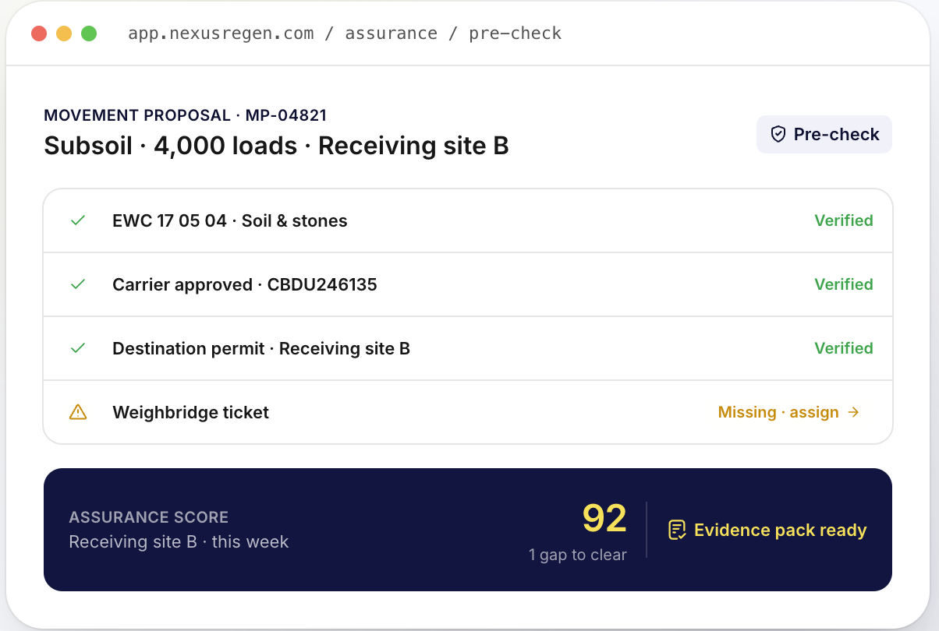
What it gives you
Single centralised compliance record
Sits above DWT and carrier systems as the authoritative point of truth, built for zero trust supply chain policy at scale.
WTN cross-referencing
Systematic checks across every movement: carrier registration, EWC code accuracy and facility permit.
Add UI screenshot here
Carrier licence monitoring
Suggested: Assurance Score or Evidence Pack
Expiry tracking and alerts across your full carrier base. Visibility to act before lapses occur.
Supply chain change flagging
Surfaces unapproved changes to carriers, brokers or facilities before they take effect.
Assurance Score
Real-time compliance signal per movement, site, project or contractor. Leadership sees where to focus.
Evidence Pack
One-click output structured for EA and HMRC. Ready in minutes, not days.
DWT integration
Draws in DWT data. One compliance system, not two.
5-year record retention
Beyond the two-year legal minimum. Post-project records matter.
Nexus ReGen | Nexus Assurance | nexusregen.com
Section 06, Nexus Assurance

Slide 32
Risk retirement
WITHOUT NEXUS ASSURANCE
WITH NEXUS ASSURANCE
Records distributed across site managers and email inboxes
Single centralised compliance record, retrievable in minutes
WTNs filed on receipt, classification assumed, no systematic verification
Systematic cross-referencing across every movement. Zero trust applied as standard
Carrier licences assumed current, expiries go unmonitored
Licence status checked and monitored. Alerts before lapses occur
Supply chain changes happen without central visibility or approval
Every change flagged automatically. Approval process enforced
EA or HMRC request triggers a manual, incomplete scramble
Evidence Pack produced in one click. Chain of custody complete
Landfill Tax liability, penalties and prosecution exposure unquantified
Exposure materially reduced. Auditable evidence of reasonable oversight
Nexus ReGen | Nexus Assurance | nexusregen.com
Section 06, Nexus Assurance

Slide 33

Scan to claim your discount
50% off
For all projects registered using the HBF associated discount in the next 30 days
usenexusregen.com/hbf
nexusregen.com | hello@nexusregen.com
Scan to claim your HBF 50% discount
Nexus ReGen | Nexus Assurance | nexusregen.com
Section 06, Nexus Assurance

Slide 34
The rules have changed.
The enforcement architecture is funded, intelligence led and expanding.
The supply chain is the primary blind spot.
The sector's largest operators have already moved.
If the Environment Agency or HMRC contacted you tomorrow, could you produce your compliance record?
Will Rundle | CEO, Nexus ReGen | nexusregen.com
Nexus ReGen | Nexus Assurance | nexusregen.com

Slide 35
Questions

Slide 36

Thank you for joining us
Follow us on LinkedIn:
the-home-builders-federation
And X: @HomeBuildersFed
Feedback on today’s session and recommendations for future sessions: comms@hbf.co.uk
Scan the QR code to view future events

